Slide 1
2021 Annual Conference
Cory O. Kirby
Harben, Hartley & Hawkins, LLP
ckirby@hhhlawyers.com

Slide 2
This year’s general assembly: the good, the Bad and the ugly

Slide 3
O.C.G.A. § 20-2-49
The General Assembly finds that local boards of education play a critical role in setting the policies that lead to the operation and success of local school systems. School board members hold special roles as trustees of public funds, including local, state, and federal funds, while they focus on the singular objective of ensuring each student in the local school system receives a quality basic education. Board duties require specialized skills and training in the performance of vision setting, policy making, approving multimillion dollar budgets, financial management and hiring a qualified superintendent. The motivation to serve as a member of a local board of education should be the improvement of schools and academic achievement of all students. Service on a local board of education is important citizen service.

Slide 4
Important Changes Beginning July 1, 2021 O.C.G.A. § 20-2-51(e)
Adds to eligibility requirements:
Has completed all prior annual training requirement established by the local board of education and the State Board of Education pursuant to Code Section 20-2-230 if such person is eligible for reelection as a member of the local board of education.

Slide 5
Important Changes Beginning July 1, 2021 O.C.G.A. § 20-2-58
It shall be the duty of each local board of education to hold a regular meeting during each calendar month for the transaction of business pertaining to the public schools and to review the financial status of the local school system….
The State Board of Education shall create a template for local boards of education to use to review the financial status of their local school systems, which shall include at a minimum, a statement of revenues, expenditures, and encumbrances.

Slide 6
Important Changes Beginning July 1, 2021 O.C.G.A. § 20-2-103
Before entering upon the discharge of his or her duties, the local school superintendent shall take and subscribe to the following oath of office:
>>>
That I am not the holder of any unaccounted for public money due this state or any political subdivision or authority thereof and that I will manage the finances of the local school system in compliance with all applicable laws and regulations.
>>>

Slide 7
Important Changes Beginning July 1, 2021 O.C.G.A. § 20-2-67
… The Department of Audits and Accounts shall designate local school system that had had reported irregularities or budget deficits for three or more consecutive years as high-risk local school systems and … for one year or two consecutive years as moderate risk local school systems.
… The superintendent shall submit to the DOE a response to the findings and a corrective action plan approved by the local board of education at a board meeting within 120 days of receiving notice of designation…
Must be addressed in flexibility contract
SDOE shall monitor and provide support and guidance.
Superintendent has to complete training

Slide 8
Important Changes Beginning July 1, 2021 O.C.G.A. § 20-2-230
(c) The SBOE shall require each newly elected member of a LBOE to receive guidance and training regarding his or her own local system’s most recent findings and the risk status of the local school system… shall include training on the role of the local school superintendent with respect to financial management and financial governance…
(d) The SBOE shall require members of local boards of education to complete the training required under this Code Section … if the LBOE has been designated … as a high-risk local school system… or if the DOAA has determined that corrective actions have not been implemented or devised to correct serious findings….

Slide 9
Important Changes Beginning July 1, 2021 O.C.G.A. § 20-2-61
… It shall not be the role of the local board of education or individual members of such board to micromanage the superintendent in executing his or her duties, but it shall be the duty of the local board to hold the local school superintendent accountable in the performance of his or her duties;
Provided, however, that requesting and reviewing financial data and documents shall not constitute micromanagement.

Slide 10
Important Changes Beginning July 1, 2021 O.C.G.A. § 20-2-58
(b) Each local board of education shall provide a public comment period during every regular monthly meeting. Such public comment period shall be included on the agenda required to be made available and posted prior to the meeting pursuant to paragraph (1) of subsection (e) of Code Section 50-14-1. A local board of education shall not require notice by an individual more than 24 hours prior to the meeting as a condition of addressing the local board during such public comment period. The chairperson of the local board of education shall have the discretion to limit the length of time for individual comments and the number of individuals speaking for or against a specific issue.

Slide 11
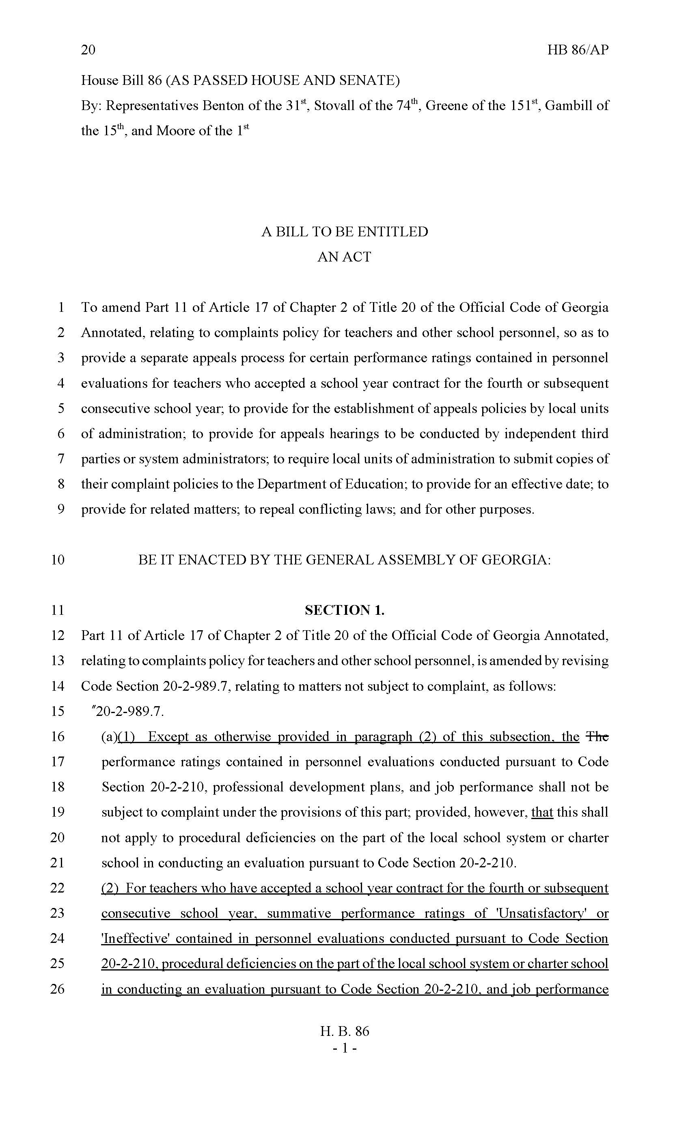
O. C. G. A. § 20-2-989.7 H. B. 86 (2020)
Adds to the State Mandated Grievance Statute a “tenure lite” provision
After 4 contracts can appeal summative ratings of U or I, procedural deficiencies and “job performance”
LUA shall establish appeals policy and submit to SDOE by 7/1/21

Slide 12
ISSUES FROM THE GENERAL ASSEMBLY

Slide 13
Teacher and Staff Compensation
$1000 Supplement
State Salary schedule
Paying for FFRCA Leave
Not a Part of the State Budget
Not a Part of the Salary Schedule
Who is Included?
Can Others be Paid and From What Funds?
What Does it Mean Anymore?
Funding and Teacher Expectation
Governor’s Run for Reelection
Contract Language Becomes Critical
First Required Federal Paid Leave
Expired 12/31/20, Voluntary through 9/30/21
Where Does the Money Come From?
Changes in Federal Leave in the Future

Slide 14
Amends Existing Georgia Special Needs Scholarship Act – SB 47
One year attendance requirement waived if Student qualifies for scholarship if:
Parent is Active Military
Adopted from foster care
Previously qualified
Special Rules for 19-20 and 20-21
Eligibility based on Student having an
IEP
Section 504 Plan for 21 specific conditions or others as determined by SBOE
Parents must receive notice of “Scholarship” when child’s eligibility for IEP/Section 504 Plan is determined
Right to Public School Choice where there is Space or Appropriate Program
Parents waive rights under IDEA and section 504 by accepting Scholarship

Slide 15
SB 51- Dexter Mosley Act
Home Study students grades 6-12 are eligible to participate in “extracurricular or interscholastic activities”:
Parent/guardian provides written notice, at least 30 calendar days before first school day of semester
Must state intent of student to participate in specific activities
Include student’s annual progress assessment report and written verification of academic progress
Home Study student enrolls and attempts to complete one course (virtual, dual-enrollment, onsite)
Must meet all eligibility requirements that public school students do - age, physical, residence, academics
Must comply with code of conduct
Must participate in tryouts and if competitive be selected
A student who withdraws from a public school to participate in home study program shall be ineligible for participation in any extracurricular or interscholastic activity for 12 months from the date of the declaration of intent to utilize a home study program provided to the Department of Education as provided under paragraph (2) of subsection (c) of Code Section 20-2-690; provided, however, that such 12 month restriction on eligibility may be waived due to hardship according to the same rules and procedures applied by a resident school, a resident school system, or an athletic association to receive, review, and grant or deny hardship waiver applications on behalf of students who attend public or private schools.

Slide 16
HB 146 Paid Parental Leave
A full time certified or classified employee may get a maximum of 15 paid school days of parental leave for:
Birth of a child
Placement of child for adoption
Placement of foster child
Must have worked 700 hours over the preceding 6-month period
15 days total during a rolling 12-month period
Available to each parent
Cannot be paid for unused leave

Slide 17
Parental Leave
Each Board of Education shall create rules governing the leave
Can run concurrent with other Federally required leave – think FMLA
What kinds of documentation will the District require?
Incremental leave

Slide 18
HB 32 – Teacher Recruitment and Retention
Qualifying teachers eligible for $3,000 tax credit for no more than 5 consecutive years
SBOE to establish program to recruit and retain teachers in high need subject areas in qualifying schools
100 participating schools from lowest 5% schools in rural territory, up to 1000 participating teachers
High need subject area to be established within resa areas based on specific criteria
Applications to DOE and local schools may access those, documentation required for tax credits

Slide 19
Sb 88 - Teacher Pipeline Bill
Teacher of the Year – Ex Officio Advisor to the SBOE
Support for non-traditional certification for veterans with qualifying bachelor’s degree and passing GACE score
If hired, eligible for 3-year provisional certificate with requirements for earning full certification

Slide 20
SB 159
Local Board of Education may use a motor vehicle with a capacity of eight persons or less operated and marked for the transportation of special education or homeless school children to and from school and school related activities
Federal and state prohibitions against 15 person vans still apply

Slide 21
HB 98
The participation by teleconference of members of agencies or committees means full participation in the same manner as if such members were physically present. In the event such teleconference meeting is a public hearing, members of the public must be afforded the means to participate fully in the same manner as if such members of the public were physically present.

Slide 22
HB 134 – Open Meetings exception – cyber protection
“Meetings when discussing or deliberating upon cybersecurity plans, procedures, and contracts regarding the provision of cybersecurity services. No vote in executive session to enter into a cybersecurity contract shall be binding on an agency until a subsequent vote is taken in an open meeting where the identity of the contractor and the terms of the agreement that are not subject to paragraph (25) of subsection (a) of Code Section 50-18-72 are disclosed before the vote.“
Open records protection for records the disclosure of which would threaten security

Slide 23
HB 156 – Reporting of Cyber Attacks
Every agency [including local school districts] shall report to the director of emergency management and homeland security, or his or her designee, any cyber attack incident, data breach, or identified use of malware on an agency or computer or network determined by the director to be the type of cyber attack, data breach, or use of malware to create a life-safety event, substantially impact the security of data and information systems, or affect critical systems, equipment, or service delivery
More rules to come

Slide 24
SB 32 – Open Records Exemption
Adds Exemption for Public Officials Personal Mobile or Cell Phone Number

Slide 25
HB 287 – Health Courses
Add Vaping and Human Trafficking to Topics Required to be Covered

Slide 26
SB 59 – EIP Not Waived by Charter System Contract AND NOT WAIVABLE THROUGH STRATEGIC SYSTEMS CONTRACT
LOCAL CHARTER TO EARN FEDERAL FUNDS FOR WHICH IT QUALIFIES UNLESS THERE IS AGREEMENT FOR IN KIND SERVICES

Slide 27
SB 246 – Learning Pods
'Learning pod' means a voluntary association of parents choosing to group their children in kindergarten through grade 12 together at various times, to include traditional before and after school hours, or places to participate in or enhance a remote learning option offered by their primary educational program. Payment for services by parents of children who participate in a learning pod does not alter this definition of a learning pod.
Participation in a learning pod to facilitate a remote learning option offered by the student's primary education provider shall satisfy all mandatory attendance requirements provided for in Code Section 20-2-690.1.

Slide 28
SB 153 – Current State Charter Alternative Schools to become Alternative Charter Schools with Special Rules

Slide 29
SB 204 – authorizes pilot program for technical college students to receive high school diploma under prescribed circumstances

Slide 30
SB 213 – Authorizes use of SPLOST proceeds for energy management and savings contracts

Slide 31
What didn’t pass but is still alive
Vouchers, Vouchers, Vouchers
The Library Bill that Deals with Alleged Pornographic Materials

Slide 32
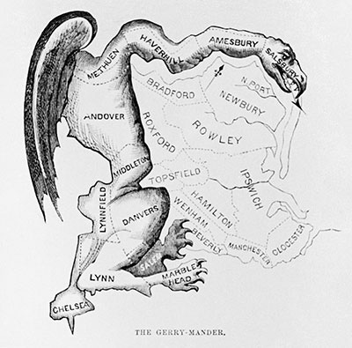
O.C.G.A. § 20-2-690
Local reapportionment legislation must be drawn or approved by the Legislative and Congressional Reapportionment Office
Member of local delegation must provide letter of sponsorship authorizing Office staff to work with local government entity to prepare plan or to review plan created separately
Otherwise, bill must have letter attached stating it cannot be certified and why
Redistricting predictions and plans: State and Local

Slide 33
Department of Labor
MESS
MESS
MESS
MESS
MESS
MESS
MESS
MESS
MESS
MESS

Slide 34
DOL issues Frequently Asked Questions
11. Will my DOL account be charged for the benefits?
You will NOT be charged for benefits paid on partial claims that you submit because of COVID-19. However, you will be charged for claims filed by your employees, and you will be required to reimburse GDOL for the total amount of benefits paid on individual-initiated claims.

Slide 35
March 2021 The Bait and Switch…

Slide 36
What to do
Pay Quarterly Bill
Just the legitimate charges?

Slide 37
Request Review
Categorize Employee Issue
No determination
Appealed
Not Eligible
Fraudulent

Slide 38
Transgender Issues

Slide 39
Title IX
“No person in the United States shall, on the basis of sex, be excluded from participation in, be denied the benefits of, or be subjected to discrimination under any education program or activity receiving Federal financial assistance.”

Slide 40
G.G. v. Gloucester Cnty. Sch. Bd., (Virginia, 4th Cir.)
Transgender male HS student was allowed to use boys’ restroom for weeks, until school got negative feedback from community
School Board adopted new restroom policy: “It shall be the practice of the GCPS to provide male and female restroom and locker room facilities in its schools, and the use of said facilities shall be limited to the corresponding biological genders, and students with gender identity issues shall be provided an alternative appropriate private facility.”

Slide 41
What the District Court held (E.D. Va. Sept. 17, 2015)…
The court dismissed the student’s claim that the school board’s policy excluding him from using the boys’ restroom based on his gender identity amounts to sex discrimination in violation of Title IX.
“The Title IX claim is precluded by Department of Education [(ED)] regulations.” Specifically, it pointed out that ED regulation 34 C.F.R. § 106.33 expressly “allows schools to provide separate bathroom facilities based upon sex, so long as the bathrooms are comparable.”

Slide 42
However, the Fourth Circuit reversed…
Referenced an opinion letter (January 7, 2015) by OCR: “When a school elects to separate or treat students differently on the basis of sex ... a school generally must treat transgender students consistent with their gender identity.”
The District Court had refused to consider the OCR opinion letter but the 4th Circuit determined that it should have given deference to OCR’s interpretation of its own regulation.

Slide 43
5/13/16 Dear Colleague Letter on Transgender Students
Schools must ensure nondiscrimination on the basis of sex includes providing transgender students equal access to educational programs and activities, even in circumstances in which other students, parents, or community members raise objections or concerns.
The desire to accommodate others’ discomfort cannot justify a policy that singles out and disadvantages a particular class of students.
Student or parent notice that a student will assert a new gender identity is sufficient to require a school to begin treating the student consistent with the student’s gender identity.

Slide 44
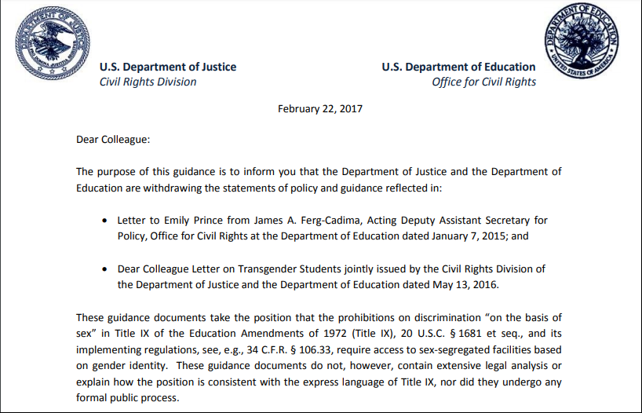
the Department of Justice and the Department of Education
are withdrawing the statements of policy and guidance
These guidance documents take the position that the prohibitions on
discrimination “on the basis of sex” in Title IX
require access to sex-segregated facilities based on gender identity.
These guidance documents do not, however, contain extensive legal
Analysis or explain how the position is consistent with the express language
of Title IX, nor did they undergo any formal public process.

Slide 45
In addition, the Departments believe that, in this context, there must be due regard for the primary role of the States and local school districts in establishing educational policy.
In these circumstances, the Department of Education and The Department of Justice have decided to withdraw and rescind the above-referenced guidance documents in order to further and more completely consider the legal issues involved. The Departments thus will not rely on the views expressed within them.
These guidance documents take the position that the prohibitions on discrimination “on the basis of sex” …
require access to sex-segregated facilities based on gender identity. These guidance documents do not, however, contain extensive legal analysis or explain how the position is consistent with the express language of Title IX, nor did they undergo any formal public process.
This interpretation has given rise to significant litigation regarding school restrooms and locker rooms.
The purpose of this guidance is to inform you that the Department of Justice
and the Department of Education are withdrawing the statements of policy and guidance reflected in:
Dear Colleague Letter on Transgender Students jointly issued by the Civil Rights Division of the Department of Justice and Department of Education dated May 13, 2016

Slide 46
Adams
1st 6 weeks of 9th grade year, Adams used Boys’ restroom
2 girls complained
Adams was given a choice:
Use gender-neutral restroom or
Use Girls’ restroom

Slide 47
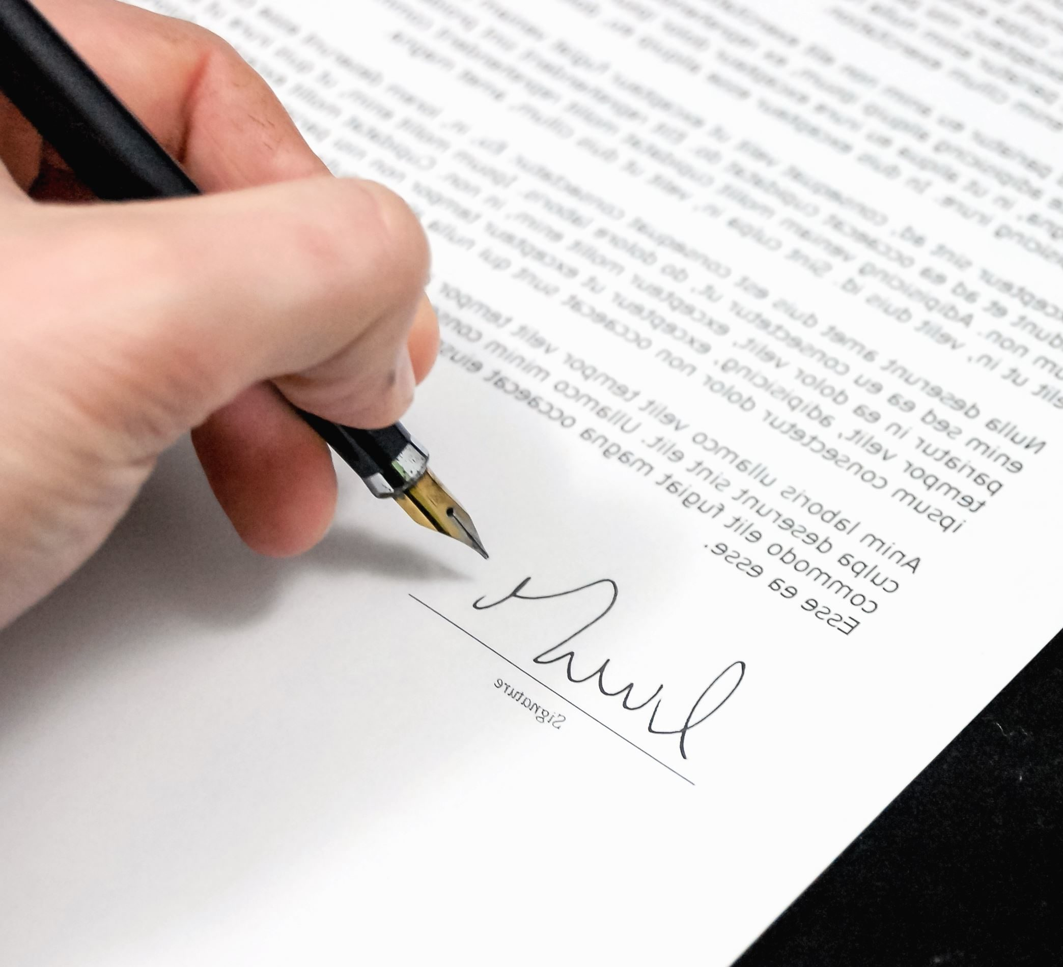
“Transgender students will be given access to a gender-neutral restroom and will not be required to use the restroom corresponding to their biological sex.”

Slide 48
Adams v. School Board of St. Johns County, Fla. (Florida Federal District Court)
“Everyone agrees that boys should use the boys’ restroom at Nease and that girls should use the girls’ restroom. The parties disagree over whether Drew Adams is a boy.”
Evidence of medical transition and legal documentation
Rules Title IX requires his use of boys’ restroom and withdrawal of guidance did not substitute substantive interpretation
If necessary, finds an equal protection violation
Finds privacy and safety concerns not warranted

Slide 49
Adams v. School Board of St. Johns County, Fla. (Florida Federal District Court)
“Biological boys” may only use boys’ restrooms or gender-neutral single-stall bathrooms and “biological girls” may only use girls’ restrooms or gender-neutral single-stall bathrooms
District Court ruled in favor of the transgender student’s claims under the Equal Protection Clause and Title IX, granting a permanent injunction ordering the Florida school district to allow the student to use the boys’ restroom on the basis of gender identity
Eleventh Circuit affirmed, relying on Bostock: “Bostock confirmed that workplace discrimination against transgender people is contrary to law. Neither should this discrimination be tolerated in schools. The School Board’s bathroom policy, as applied to Mr. Adams, singled him out for different treatment because of his transgender status.”
On August 26, 2020, the Fourth Circuit similarly rejected transgender bathroom ban in second Grimm decision

Slide 50
Bostock v. Clayton County, Ga (USSC, June 15, 2020)
3 cases, 11th Cir. Ruled that Sexual Orientation Not Protected by Title VII, 2nd Cir. Ruled that It Was; 6th Cir. Ruled that Gender Identity Was Protected
“Because discrimination on the basis of homosexuality or transgender status requires an employer to intentionally treat individual employees differently because of their sex, an employer who intentionally penalizes an employee for being homosexual or transgender also violates Title VII.”

Slide 51
Although Title VII and Title IX are separate substantive provisions of the Civil Rights Act of 1964, both titles protect discrimination against individuals on the basis of sex

Slide 52
Adams v. School Bd. of St. Johns Cnty. (11th Cir. Aug. 7, 2020)
Decision in favor of student, 2-1 ; motion for rehearing en banc pending
Active judges on full court: 6 by Trump, 4 by Obama, 1 by Bush and 1 by Clinton
The Court focused on how this student was treated differently from other students and refused to address whether sexually separated restrooms were constitutional or whether “sex” in Title IX specifically includes gender identity

Slide 53
Are Teachers Essential Workers or Not?
The Department Homeland Security made clear that all school employees are essential workers, and that education is a part of the critical infrastructure.
The Governor adopted DHS guidance until this was added.
Local DPH’s did not seem to agree.
So, What:
Is it more essential for school employees to come to work or grocery baggers?
But what if they have underlying conditions putting them at risk?
But what is essential workers get vaccinations at a higher priority?
WHAT HAS THE LAST YEAR DONE FOR THE REPUTATION OF EDUCATORS?

Slide 54
Federal Leave Laws
Families First Coronavirus Response Act
Emergency Paid Sick Leave Act
Emergency Family Medical Leave Expansion Act
Effective April 1, 2020, and Expired December 31, 2020
First Federal Leave Statutes to Require Pay
First FMLA Reason to Require Pay
Provided No Direct Funding

Slide 55
Emergency Paid Sick Leave
Available to All Employees
Full time Employees Eligible for 80 hours (basically 2 weeks)
Part-time Employees Eligible for average hours worked over 2 weeks
Advance Notice from Employee Not Required, Reasonable Notice after First Day Can be Required
Name, Dates for leave, Qualifying reason, Statement that this is reason Employee Cannot Work
Name of child, name of school that is closed, representation that no one else is available
Regular pay not to exceed $511 per day for reasons 1, 2 and 3
Two-thirds of regular pay not to exceed $200 per day for reasons 4, 5, and 6
EPSLA takes precedence over other leave available

Slide 56
Emergency Family and Medical Leave Expansion Act
Adds to Existing FMLA: Employee is unable to work or telework due to a need for leave to care for child under 18 if school or daycare is unavailable due to public health emergency
Eligible if Employee has been working 30 days
Up to 12 weeks, but is cumulative with any and all other FMLA
No pay for first two weeks (but see EPSLA above) and after that at 2/3 rate of pay up to $200 per day
Neither Employer or Employee May Substitute other Leave, but by Agreement May Supplement Leave, also Intermittent Leave Must be By Agreement

Slide 57
Covid Leave in 2021
From January 1 through March 31 Mandated Covid Leave Not Continued
Employers Are Allowed to Voluntarily Continue Covid Leave
Private Employers Are Entitled To Tax Credit to Reimburse for Decision to Keep Paying Leave
Public Entities (School Districts) Not Included in Tax Credit Entitlement

Slide 58
American Rescue Plan 4/1/21 – 9/30/21?
Continues the Voluntary Extension of EPSLA and EFMLA and Tax Credits
Adds Additional Reasons for EPSLA
Awaiting Results of Covid Test
Getting a Covid Vaccination
Recovering from Condition Related to Vaccination
Any of the EPSLA reasons now qualify for EFMLA, and EPSLA 80 Hours Starts Over
Removes the Exclusion of Governmental Entities
So What Would a Tax Credit Mean?

Slide 59
Covid 19 and the ADA - Section 504
Like All Issues Dealing with Disabilities in the Workplace, Many Have to Be Analyzed on an Individualized Basis
In General, Having COVID 19 or Being Exposed to It Are Probably Not Qualifying Conditions under ADA, but having a condition that puts an employee at Greater Risk for COVID probably is, either ADA or ADEA
But Being Afraid of COVID 19 Probably is Not a Qualifying Condition
Retaliation for Taking Leave Under the New Acts is Prohibited
When is Teleworking a Required Accommodation? An Acceptable Accommodation? Is That Going to Change Over Time?

Slide 60
And then what?
Can You Mandate Quarantine? Based on What Evidence?
When the Employee Disagrees?
Who Pays and What Do We Call It?
Will Immunization Become a Requirement?

