Slide 1
Cory O. Kirby
Harben, Hartley & Hawkins, LLP
ckirby@hhhlawyers.com

Slide 2
ISSUES FROM THE GENERAL ASSEMBLY

Slide 4
Recess Bill O.C.G.A. § 20-2-323
Starting with 2019-2020 school year, K-5 grade shall have scheduled recess
Not on days with physical education or weather issues
Elementary Schools “encouraged” to include 30 minutes of unstructured activity, preferably outdoors
Local Board of Education shall establish written policies to ensure “’that recess is a safe experience for students, that recess is scheduled so that it provides a break during academic learning, and that recess is not withheld for disciplinary or academic reasons.”

Slide 5
Bus Driver’s Data Base O.C.G.A. § 20-2-211
LBOE shall furnish names and driver’s license numbers of all bus drivers, twice a year; DPS maintain data base on status of license and immediately notify LBOE when suspended or revoked
Also allows nonsworn law enforcement employees to do traffic control with one hour of training
3

Slide 6
O.C.G.A. § 16-6-5.1 Sexual assault by persons with supervisory or disciplinary authority
To amend Title 16 of the Official Code of Georgia Annotated, relating to crimes and offenses, so as to revise the crime of sexual assault by persons with supervisory or disciplinary authority; to provide for degrees of the crime; to change provisions relating to punishment; to prohibit sexual extortion; to provide for elements of the crime; to provide for an exemption; to provide for penalties; to provide for venue; to amend Code Sections ..relating to punishment for sexual offenders, review of individual’s criminal history record information, definitions, privacy considerations, written application requesting review, and inspection, the State Sexual Offender Registry, immunity from liability of certain facilities, respectively, so as to make conforming and correct cross-references; to review and provide for definitions; to provide for effective dates; to provide for related matters; to repeal conflicting laws; and for other purposes.

Slide 7
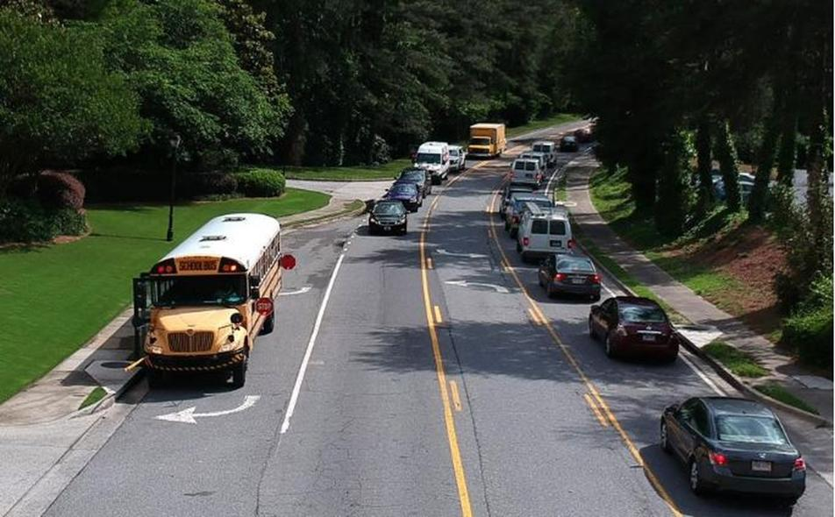

Slide 8
Stopping for School Buses
O.C.G.A. § 40-6-163(b):
“The driver of a vehicle upon a highway with separate roadways or a divided highway, including but not limited to, a highway divided by a turn lane, need not stop upon meeting or passing a school bus which is on a different roadway or on another half of a divided highway, or upon a controlled-access highway when the school bus is stopped in a loading zone which is a part of or adjacent to such highway and where pedestrians are not permitted to cross the roadway.”

Slide 9
Stopping for School Buses O.C.G.A. § 40-6-163(b)
(b) The driver of a vehicle upon a highway with separate roadways or a divided highway, including, but not limited to, a highway divided by a turn lane, that are separated by a grass median, unpaved area, or physical barrier need not stop upon meeting or passing a school bus which is on a different the separate roadway or on another half of a divided highway, or upon a controlled access highway when the school bus is stopped in a loading zone which is a part of or adjacent to such highway and where pedestrians are not permitted to cross the roadway.

Slide 10
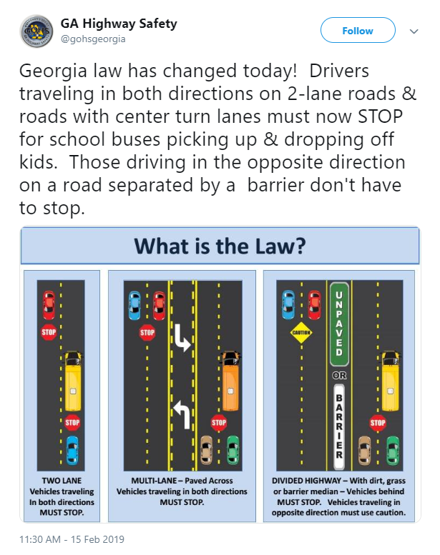

Slide 11
Capital Outlay after Disaster O. C. G. A. § 20-2-260
Damage or destruction of an educational facility by natural occurrences
A “majority” of facility destroyed
Immediately qualify for State Capital Outlay and Advance Funding
So long as facility is 20 years old or older

Slide 12
Georgia Procurement Registry O.C.G.A. § 36-80-27
If a bid or proposal opportunity is extended by a county municipal corporation, or local board of education for goods, services or both valued at $100,000 or more of if a bid or proposal opportunity is extended for public works construction contracts subject to Chapter 91 of this title, such bid or proposal opportunity shall be advertised by such respective local governmental entity in the Georgia Procurement Registry, as established in subsection (b) of Code Section 50-5-69, at no coast to the local governmental entity.

Slide 13
Competitive Process O.C.G.A. § 36-91-1 et seq
"Public works construction" means the building, altering, repairing, improving, or demolishing of any public structure or building or other public improvements of any kind to any public real property other than those projects covered by Chapter 4 of Title 32. Such term does not include the routine operation, repair, or maintenance of existing structures, buildings, or real property.
Two Forms
Bid
Proposal

Slide 14
Competitive Process O.C.G.A. § 36-91-1 et seq
BIDS
Award to the lowest responsible and responsive bidder whose bid meets the requirements and criteria set forth in the invitation for bids
Proposals
Award to the responsible and responsive offeror whose proposal is determined in writing to be the most advantageous to the governmental entity, taking into consideration the evaluation factor… in the request for proposal.

Slide 15
Keeping Georgia’s Schools Safe Act O.C.G.A. § 20-2-1185
Site Assessments each 5 years by trained individuals or government agencies
Safety plans reviewed and updated annually as necessary, submitted to SDOE after approval by law enforcement “designated as having approval authority by LBOE.” List of approved plans posted online
Mass casualty drills at least once a year, student participation discretionary
LBOE annual report to the public, including funding
Principal or designee serves as school safety coordinator who shall issue report, coordinate, “when reasonable suspicion of violent criminal activity exists, report to law enforcement”
Post paper and website display of GBI reporting app; GBI with enhanced role in these emergencies
3

Slide 17
Sudden Cardiac Arrest Prevention Act O. C. G. A. § 20-2-324.4
State Department of Education will create and post on its website guidelines and educational material regarding the nature and warning signs of sudden cardiac arrest including:
Fainting or seizures during exercise, unexplained shortness of breath, chest pains, dizziness, racing heart rate, or extreme fatigue.

Slide 18
Sudden Cardiac Arrest Prevention Act O. C. G. A. § 20-2-324.4
Prior to participating in an interscholastic athletic event, a student’s parent must sign and return to school acknowledgement of receipt and review of the sudden cardiac arrest symptoms and warning signs.
School must hold informational meeting regarding symptoms and signs.
(d)(1) A student who passes out or faints while participating in, or immediately following, an interscholastic athletic activity, or who is known to have passed out or fainted while participating in or immediately following an interscholastic athletic activity, shall be removed from participation in the interscholastic athletic activity at that time by the athletic director, coach or athletic trainer.
(2) A student who exhibits any of the other symptoms set forth in paragraph (1) of subsection (b) of this Code section while participating in, or immediately following, an interscholastic athletic activity may be removed from participation in the interscholastic athletic activity by an athletic trainer, if the athletic trainer reasonably believes that such symptoms are cardiac related. In the absence of an athletic trainer, coaches who observe any of the other symptoms set forth in paragraph (1) of subsection (b) of this Code section may notify the parents or guardians of such student so that the parents or guardians can determine what treatment, if any, such student should seek.
(3) A student who is removed from participation in an interscholastic athletic activity pursuant to this subsection shall not be permitted to return to participation in an interscholastic athletic activity until such student is evaluated and cleared for return to participation in writing by an appropriate health care provider.

Slide 19
Immunity O. C. G. A. § 5-6-34
Waives immunity as to constitutional claims against the state
Waives immunity as to nonmonetary claims against cities and counties but not school districts
3

Slide 20
Education Funding
On the campaign trail, Governor Kemp promised a $5,000 pay raise for all public school teachers in Georgia. In the Fiscal Year 2020 budget, he succeeded in taking the first steps towards fulfilling that promise. The Georgia General Assembly adopted a $27.5 billion budget for the 2020 Fiscal Year, which included a $3,000 pay raise for certified teachers and certified personnel. Governor Kemp has committed that this is the first installment towards a total raise of $5,000. Continuing their long-time commitment to education, the House and Senate expanded the $3,000 raise to include school counselors, social workers, psychologists, special education specialists, speech and language pathologists, media specialists, and technology specialists. The 8.8 percent increase to the state’s salary schedule accounts for more than half of the $1.05 billion in additional appropriations over the FY2019 budget. Also recognized in the FY2020 budget are bus drivers, lunchroom workers, school nurses and assistant pre-K teachers, who will all receive a 2 percent pay raise.

Slide 21
The Conference Committee on the FY '20 budget wasted no time coming to agreement. They finished yesterday and both chambers adopted it today. The Department of Education section begins on page 93 of the document. Here are a few of the changes from previous versions of the budget:
$522 million for a $3000 raise for certified employees beginning July 1, 2019 -- budget writers had to find $86 million more to start the raise in July instead of September
$12.2 million in bonds for vocational equipment
$4.2 million increase for dual enrollment plus $1 million to establish funding for an Early HOPE program for those in dual enrollment
$2 million for charter school facilities grants
$1 million for grants to schools for feminine hygiene products for low-income students
$1 million for additional high school counselors and enriching counselor programs for Title I schools
$968,634 increase in sparsity grants -- the budget also directs a study to be done over the summer to come up with a plan for updating the sparsity grant formula
$750,000 for professional development to implement SB 108, the computer science bill
$413,000 increase to RESAs by reducing austerity to the base formula
$274,920 for three school safety coordinators and for operations (Emergency Management and Homeland Security Agency)
$200,000 to expand the Communities in Schools model of wraparound services
We appreciate all the efforts of the Governor, Lt. Governor, legislators and budget staff to fund all these needs. There were some big shifts in the money needed, and it's hard to do that. Between the supplemental budget and this one, the Governor kept those campaign promises about school safety funding and got 60% of the teacher pay raise done in his first year. What an excellent start for a new administration.

Slide 22
Charter School Law O.C.G.A. § 20-2-2065
(a) Except as provided in this article or in a charter, a charter school, or for charter systems, each school within the system, shall not be subject to the provisions of this title or any state or local rule, regulation, policy, or procedure relating to schools within an applicable school system regardless of whether such rule, regulation, policy, or procedure is established by the local board, the state board, or the Department of Education;

Slide 23
Strategic Waiver School System Law O.C.G.A. § 20-2-82
(e) The state board shall be authorized to approve a waiver or variance request of specifically identified state rules, regulations, policies, and procedures or provisions of this chapter upon the inclusion of such request in the local school system's proposed contract and in accordance with subsection (b) of Code Section 20-2-84.

Slide 24
What must be waived in SWS systems under O.C.G.A § 20-2-84?
(b) The flexibility component of the contract…shall include the waiver or variance of at least one of the areas in paragraphs (1) through (4) of this subsection as requested by the local school system:
1) Class size requirements in Code Section 20-2-182;
2) Expenditure controls in Code Section 20-2-171 and categorical allotment requirements in Article 6 of this chapter;
3) Certification requirements in code Section 20-2-200;
4) Salary schedule requirements in Code Section 20-2-212; and
5) Any other requirements or provisions of this chapter as identified by the local school system and approved by the state board except as provided in subsection (e) of Code Section 20-2-82.

Slide 25
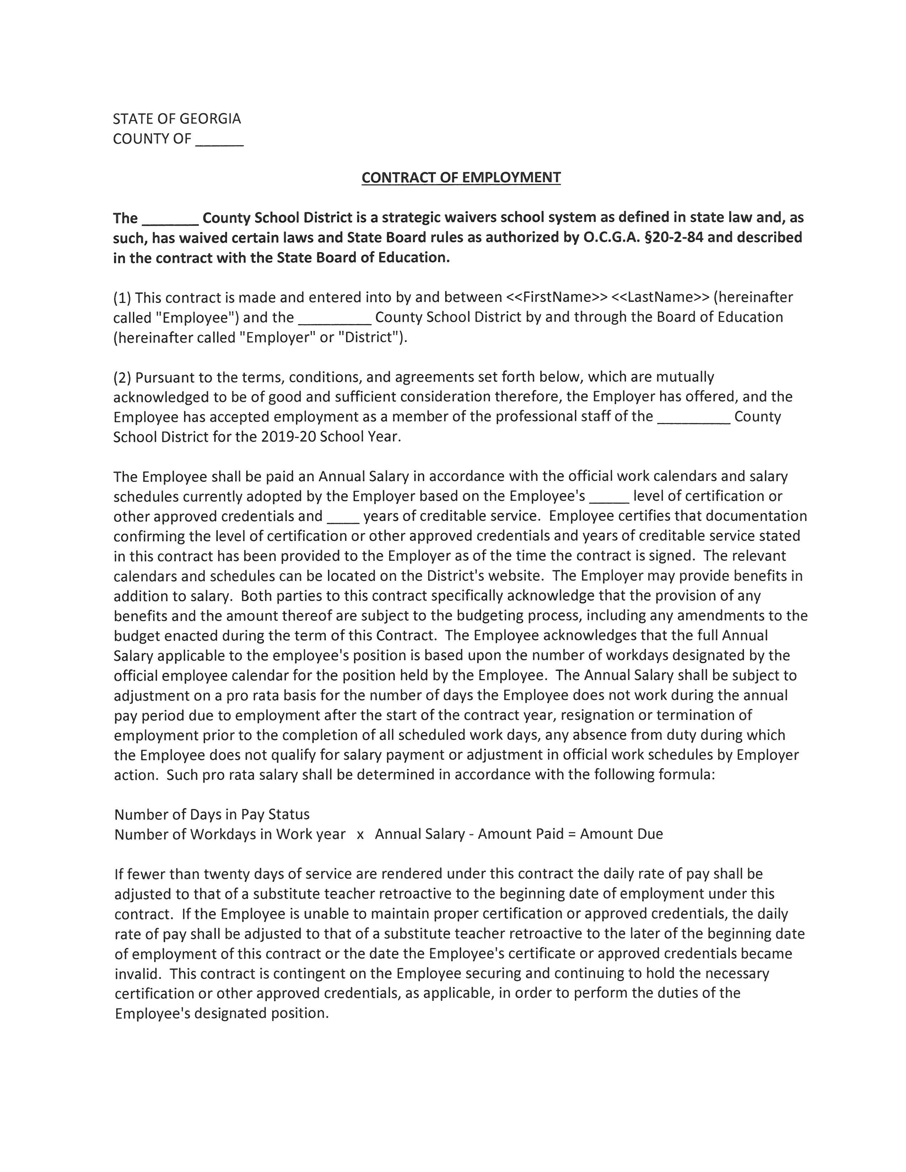
The Employee shall be paid an Annual Salary in accordance with the official work calendars and salary schedules adopted by the Employer based on the Employee’s ____ level of certification or other approved credentials and ___ years of creditable service…
The relevant calendars and schedules can be located on the District’s website.

Slide 26
Consultant Conflict O.C.G.A. § 36-80-28
Consultants are engaged to develop/draft specs or requirements for solicitation or sere as consultant during competitive process
(b) Consultants who enter into contracts or arrangements with counties, municipalities, school boards, and other local governmental entities to prepare or develop specifications or requirements for bids, requests for proposals, procurement orders, or purchasing orders for such county, municipality, school board or other local governmental entity shall, at the time of entering into such contracts or arrangement, execute an agreement which provides that.
(1) the consultant shall avoid any appearance of impropriety and shall follow all policies and procedures of the county, municipality, school board, or other local governmental entity with whom the consultant is entering into contract or arrangement;

Slide 27
Consultant Conflict O.C.G.A. § 36-80-28
(2) The consultant shall immediately disclose to such county, municipality, school board, or other local governmental entity any material transaction or relationship, including, but not limited to, that of the consultant, the consultant’s employees, or the consultant’s agents or subsidiaries, that reasonably could be expected to give rise to a conflict of interest, including, but not limited to, past, present, or known prospective engagements, involvement in litigation or other dispute, client relationships, or other business or financial interest, and shall immediately disclose any material transaction or relationship subsequently discovered during the pendency of the contract or arrangement; and
(3) An acknowledgment that any violation or threatened violation of the agreement may cause irreparable injury to the county, municipality, school board, or other local governmental entity, entitling such county, municipality, school board, or other local governmental entity, to seek injunctive relief in additional to all other legal remedies.
What About Attorney?

Slide 28
DID NOT PASS

Slide 29
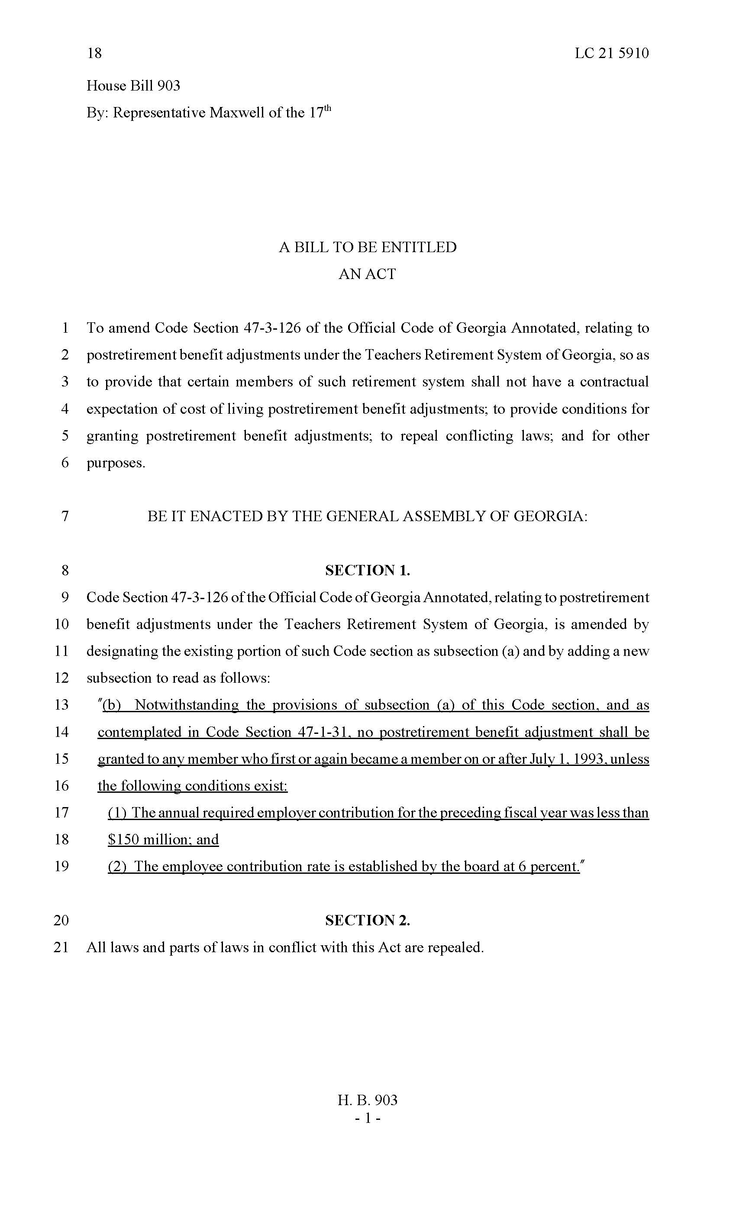
HB 903
Teachers’ Retirement System
DID NOT PASS
"(b) Notwithstanding the provisions of subsection (a) of this Code section, and as
contemplated in Code Section 47-1-31, no postretirement benefit adjustment shall be
granted to any member who first or again became a member on or after July 1, 1993, unless
the following conditions exist:
(1) The annual required employer contribution for the preceding fiscal year was less than
(2) The employee contribution rate is established by the board at 6 percent."

Slide 30
Georgia Education Scholarship Act SB 173
DID NOT PASS
Establishes a “scholarship” account of State Funds to be used by
the parent or other individual with legal authority to act on behalf
of a student for qualified education expenses at a participating school

Slide 31
How is the scholarship funded?
Account funds are State Funds deposited into the account
to be used by the students’ parent

Slide 32
For students with IEP: an amount equivalent to the cost of the educational program
that have been provided for the student in the public school in which the student would
have been enrolled based on their residence.
All other students: an amount equal to 100% of the system-wide average per
student amount of State Funds for students’ resident school district.

Slide 33
How does a student obtain the scholarship account?
To qualify, a student must meet one of the following:
The student’s parent or parents currently reside within Georgia;
The student has:
A family income below 200 percent of the federal poverty level and is currently enrolled in a public school in this state;
Been adopted from foster care;
A parent who is an active duty military service member stationed in Georgia within the previous year;
One or more of the following disabilities and has an Individualized Education Program (IEP) written in accordance with federal and state laws and regulations and is currently enrolled in a public school in this state;
Autism;
Deaf/blind;
Dear/hard of hearing;

Slide 34
How does a student obtain the scholarship account?
Emotional and behavioral disorder;
Intellectual disability;
Orthopedic impairment;
Specific learning disability;
Speech-language impairment;
Traumatic brain injury; or
Visual impairment
A documented case of having been bullied and is currently enrolled in a public school in the state; or
Spent the prior school year in attendance at a Georgia public school system or school systems for funding purposes during the preceding October and March full-time equivalent (FTE) program counts in accordance with Code Section 20-2-160;

Slide 35
Student must submit application to the Governor’s Office of Student Achievement
First year acceptance shall be no more than one-half of 1 percent of statewide total public school enrollment for school year 2017-2018
Increases by an additional one-half of 1 percent each subsequent year for a maximum of 5 percent

Slide 36
On what can the account funds be expended?
The account funds can be expended for the following qualified educational expenses:
Tuition, fees, and required textbooks at a participating school;
Tuition, fees, and required textbooks at a community college or accredited postsecondary institution;
Tutoring services provided by an educator certified by the Professional Standards Commission;
Payment for the purchase of a curriculum including any supplemental materials required by the curriculum;
Tuition and fees for a nonpublic online learning program or course;
Services from a physician or therapist licensed pursuant to Chapter 10A, 28, 33, 34, or 44 of Title 43, including, but not limited to, for occupational, behavioral, physical, or speech-language therapies;
No more than $500.00 per year to a fee-for-service transportation provider for transportation to or from a participating school or service provider;
Fees for the management of account funds in accordance with subsection (e) of Code Section 20-2B-7; or
Computer hardware or other technological devices approved by the office or a physician if the computer hardware or other technological device is used to meet the student’s educational needs.

Slide 37
What kinds of schools can students attend with these funds?
A nonpublic school, sectarian or nonsectarian, which is accredited or in the process of accreditation and that has notified the Governor’s Office of Student Achievement of its intention to participate its acceptance of requirements.

Slide 38
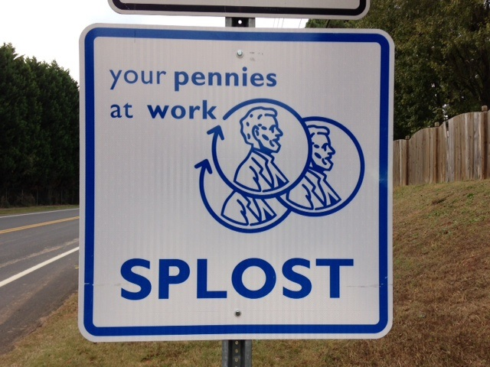

Slide 39
Ballot Question
Shall a special 1 percent sales and use tax be imposed in the special district of ______ County for a period of time not to exceed _____ and for the raising of an estimated amount of $_________ for the purpose of ___________.
( ) Yes
( ) No
O.C.G.A. § 48-8-111(c)(1)

Slide 40
If Debt included …
“If imposition of the tax is approved by the voters, such vote shall also constitute approval of the issuance of general obligation debt of ________ in the principal amount of $_________ for the above purpose.”
O.C.G.A. § 48-8-111(c)(2)

Slide 41
Use of SPLOST Funds
“The proceeds received from the tax authorized by this part shall be used by the county and qualified municipalities within the special district receiving proceeds of the sales and use tax exclusively for the purpose or purposes specified in the resolution or ordinance calling for imposition of the tax.”
O.C.G.A. § 48-8-120(a)(1)

Slide 42
Referendum Resolution - O.C.G.A. § 48-8-111
Should specify purpose for which proceeds of tax are to be used/expended
Capital outlay projects:
paying a portion of the debt service payments due on outstanding General Obligation Bond
adding to, renovating, repairing, improving, furnishing, equipping, demolishing and completing existing school buildings and other buildings and facilities useful and desirable in connection therewith, including, but not limited to, physical education/athletic fields and facilities, paving and technology infrastructures;
acquiring technology improvements, including safety and security improvements, computer technology, hardware and software;
acquiring, constructing and equipping new school buildings and other buildings and facilities useful and desirable;
acquiring new school equipment, including, but not limited to, new buses, maintenance vehicles and equipment;
acquiring textbooks and instructional materials and equipment;
acquiring any necessary or desirable property, both real and personal.

Slide 43
How is Capital Outlay for Educational Purposes Defined?
Ga. Op. Atty. Gen. No. 97-7
…major, permanent, or long-lived improvements or betterments, such as would be properly chargeable to a capital asset account and as distinguished from current expenditures and ordinary maintenance expenses.

Slide 44
Do School Districts Really have Independent Contractors?
Is this Really an Issue?

Slide 45
The Players
Internal Revenue Service
Georgia Department of Revenue
Georgia Department of Labor
Social Security
Insurance Company (workers compensation, State Health Benefit Plan)
TRS/ERS
EEOC

Slide 46
The Tests
The IRS subscribes to the “right to control” test
According to the IRS, an employer/employee relationship exists when the alleged employer has the right to control and direct the alleged employee performing the work
Results of work
Areas work is completed
Doesn’t actually have to enforce control, just has to have the right

Slide 47
The IRS identified 20 factors to be used to determine “whether
Sufficient control is present to establish an employer-employee relationship”

Slide 48
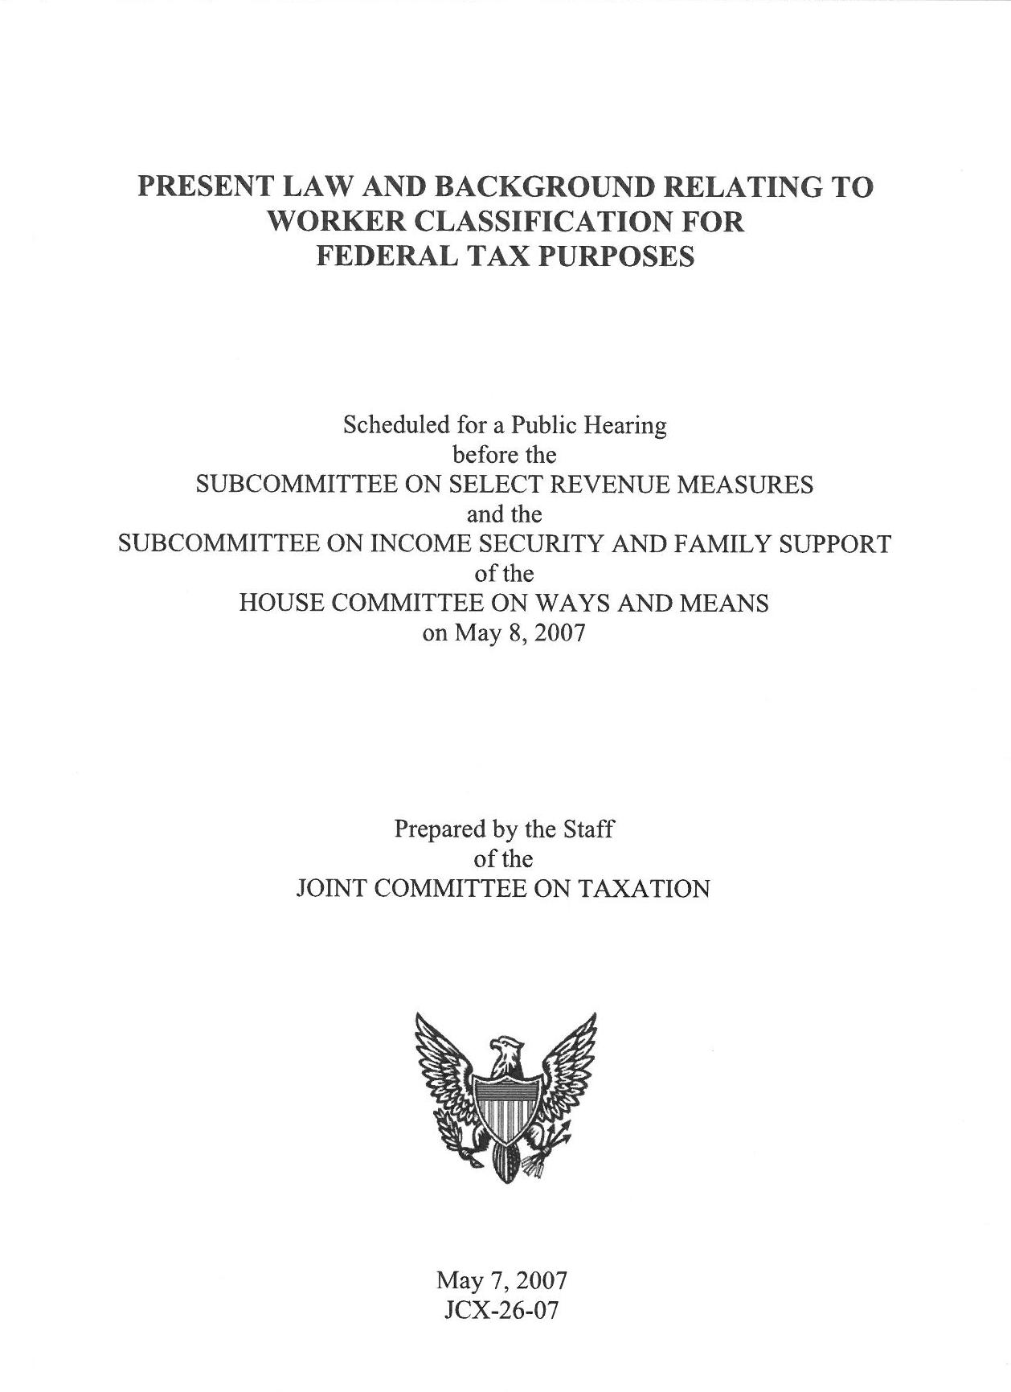
The 20 factors identified by the IRS are as follows:
Instructions: whether an individual is required to comply with other person’s instructions;
Training: mandated training indicates that the services are required to be performed in a certain method or manner;
Integration: integration of the worker’s services into the business operations;
Services rendered personally;
Hiring, supervision, and paying assistants;
Continuing relationship;
Set hours of work;
Full time required;
Doing work on employer’s premises;
Order or sequence set;
Oral or written reports;
Payment by the hour, week, or month;
Payment of business, and/or traveling expenses;
Furnishing tools and materials;
Significant investment;
Realization of profit or loss;
Working for more than one firm at a time;
Making service available to the general public;
Right to discharge; and
Right to terminate.

Slide 49
The 20 factors have been grouped into 3 main categories:
Behavioral Control
Financial Control
Relationship of the Parties

Slide 50
Behavioral Control
Facts and factors evidence a right to control worker’s work – i.e. direct and control the worker
Goes back to the 1930’s and New Deal Legislation
Changes “servants” to “independent contractors”
A – Does worker receive “instructions”?
Instructions: If the person for whom the services are performed has the right to require
Compliance with instructions, this indicates employee status.
Hiring, supervision, and paying assistants: If the person for whom services are performed hires,
Supervises or pays assistants, this generally indicates employee status. However, if th worker hires
and supervises others under a contract pursuant to which the worker agrees to provide material and labor and is only responsible for the result, this indicates independent contractor status.
Furnishing tools and materials: The provision of significant tools and materials to the worker
Indicates employee status.

Slide 51
Behavioral Control
B – Does employee receive training?
2. Training: Worker training (e.g. by requiring attendance at training sessions)
indicates that the person for whom services are performed wants the services performed
in a particular manner (which indicates employee status).
Order or sequence test: If a worker must perform services in the order or sequence set by
the person for whom services are performed, that shows the worker is not free to follow his or her own pattern of work, and indicates employee status.

Slide 52
Financial Control
Facts and factors demonstrate a right to control the “business part” of the work
3. Integration: Integration of the worker’s services into the business operations of the
person for whom services are performed is an indication of employee status.
15. Significant investment: Investment in facilities used by the worker indicates
independent contractor status.
13. Payment of business and/or traveling expenses: If the person for whom the
services are performed pays expenses, this indicates employee status. An employer, to
control expenses, generally retains the right to direct the worker.
16. Realization of profit or loss. A worker who can realize a profit or suffer a loss as a
result of the services (in addition to profit or loss ordinarily realized by employees) is
generally an independent contractor.

Slide 53
Relationship of the Parties
Facts and factors evidencing the perceived relationship of the parties
13. Payment of business and/or traveling expenses: If the person for whom the
services are performed pays expenses, this indicates employee status. An employer, to
control expenses, generally retains the right to direct the worker.
19. Right to discharge: The right to discharge a worker is a factor indicating that the
worker is an employee.
Right to terminate: If a worker has the right to terminate the relationship with the
person for whom services are performed at any time he or she wishes without
incurring liability, that indicates employee status.

Slide 54
Georgia Courts

Slide 55
Yearwood v. Peabody 45 Ga.App. 451 (1932)
Issue: Whether employee is servant or independent contractor
“[T]he test to be applied in determining whether the relationship of the relationship of the parties under a contract for the performance of labor is that of employer and servant, or that of employer and independent contractor, lies in whether the contract gives, or the employer assumes, the right to control the time, manner, and method of executing the work, as distinguished from the right merely to require certain definite results in conformity to the contract.”

Slide 56
A.J. Hodges et al. v. Doctors Hospital 141 Ga.App. 649 (1977)
“The sole question raised by appellant is whether the evidence demanded a finding in favor of the defendant hospital. This necessarily involves a determination of … whether the doctor who treated the deceased and whose alleged negligence caused the wrongful death was an employee of the hospital or was an independent contractor”.
“In ascertaining what relation exists, the requirements are neither complex nor uncertain but their application is extremely difficult. The true test of whether the relationship is one of employer-employee or employer-independent contractor is whether the employer, under the contract either oral or written, assumes the right to control the time, manner and method of executing the work, as distinguished from the right merely to require certain definite results in conformity to the contract”.

Slide 57
Georgia law defines Employee
O.C.G.A. § 20-2-211(a) …Employment contracts of teachers, principals, and other certificated professional personnel shall be in writing…
O.C.G.A. § 20-2-850(a)(1)… Each person employed in any public school system of this state in the capacity of teacher, student services support personnel, or administrative and supervisory personnel, hereinafter referred to in this part as "personnel," as classified by the Professional Standards Commission pursuant to subsection (a) of Code Section 20-2-200, except county or regional librarians, shall be entitled to sick leave with full pay…

Slide 58
Georgia law defines Employee
O.C.G.A. § 20-2-874
(12) “Eligible to participate” means employees of employers who are participating in one of the health plans and those employees of employers who qualify to participate in the health plan but choose not to do so.
O.C.G.A. § 20-2-880
(4) "Public school teacher," "teacher," and "employee" mean any person employed not less than half time in a professionally certificated capacity or position in the public school systems of this state. "Public school teacher," "teacher," and "employee" also mean librarians and other personnel employed by regional and county libraries or the high school program of Georgia Military College. "Public school teacher," "teacher," and "employee" also mean any professionally certificated person who has acquired ten years or more of creditable service and who is being paid retirement benefits by the Teachers Retirement System of Georgia, Chapter 3 of Title 47, or by any other public school teacher retirement system in this state. "Public school teacher," "teacher," and "employee" also mean any person employed not less than half time and compensated in a professionally certificated capacity or position in a charter school in this state established pursuant to Article 31 of Chapter 2 of Title 20 if such charter school elects upon initial approval of its charter or, if such charter school is an existing charter school, elects upon notice by the health insurance plan provided in this part or upon the expiration of its current health care plan or by no later than December 31, 2009, to participate in the health insurance plan established pursuant to this subpart. "Public school teacher," "teacher," and "employee" shall not be deemed to include any emergency or temporary employee. Notwithstanding this definition or any other provision of this subpart, the board may, by regulation, make available to employees who work 17 1/2 hours or more per week such benefits as are required to be made available to such employees by regulations of the United States Internal Revenue Service or any other federal authority.

Slide 59
Georgia law defines Employee
O.C.G.A. § 20-2-910
(3) "Public school employee" means an "employee" as defined in paragraph (20) of Code Section 47-4-2. "Public school employee" also means classroom aides, paraprofessionals, and noncertified administrative and clerical personnel. It is specifically provided, however, that the term "public school employee" shall not include any emergency or temporary employee or any other employee who works in a position otherwise covered by such term less than 60 percent of the time required to carry out the duties of such position. "Public school employee" also means any person, other than an employee in a professionally certificated capacity or position, employed not less than half time and compensated in a charter school in this state established pursuant to Article 31 of Chapter 2 of Title 20 if such charter school elects upon initial approval of its charter or, if such charter school is an existing charter school, elects upon notice by the health insurance plan provided in this part or upon the expiration of its current health care plan to participate in the health insurance plan established pursuant to this subpart. Notwithstanding this definition or any other provision of this subpart, the board may, by regulation, make available to employees who work 17 1/2 hours or more per week such benefits as are required to be made available to such employees by regulations of the United States Internal Revenue Service or any other federal authority.

Slide 60
Georgia law defines Employee
O.C.G.A. § 47-3-21
(28) "Teacher" means: (A) Any of the following persons employed not less than half time by a public school:
(B) Public school nurses who are employed on a regular basis as much as one-half time or more. The employer's contributions for such public school nurses on all salary amounts which are not paid from state funds shall be paid from local funds;
The term "teacher" shall not be deemed to include any emergency or temporary employee. The term "teacher" shall not include an individual classified by an employer as an independent contractor or a leased employee within the meaning of Section 414(n) of the federal Internal Revenue Code, even if such individual is later reclassified by the Internal Revenue Service as a common law employee. The board of trustees shall determine in doubtful cases whether any person is included within the definition set forth in this paragraph. Notwithstanding the provisions of subparagraphs (N) and (P) of this paragraph, no person becoming an employee of the Georgia Association of Educators, the Georgia High School Association, or the Georgia School Boards Association or becoming the executive secretary of the Georgia Vocational Association after June 30, 1984, shall be a "teacher" within the meaning of this paragraph or shall be eligible for membership in the retirement system provided for by this chapter unless the person holding any such position is also a "teacher" within the meaning of a subparagraph of this paragraph other than subparagraph (N) or (P) of this paragraph. Except as otherwise provided by Code Section 47-3-84.2, subparagraphs (N) and (P) of this paragraph shall remain effective after June 30, 1984, only for the purpose of allowing any person who was a member of the retirement system on June 30, 1984, because the person held a position specified by subparagraph (N) or (P) of this paragraph to continue such membership as long as the person continues to hold such position.

Slide 61
Georgia law defines Employee
O.C.G.A. § 47-4-2
(20) “Public school employee” or “employee” means all those employees of public schools including postsecondary vocational-technical schools governed by the Technical College System of Georgia who are not eligible for membership in the Teachers Retirement System of Georgia or the Employees' Retirement System of Georgia. The term specifically includes, but is not limited to, school bus drivers, school lunchroom personnel, school maintenance personnel, and school custodial personnel. The term does not include teachers or any school personnel who are now, or may hereafter become, covered by the Teachers Retirement System of Georgia or the Employees' Retirement System of Georgia, any person on the payroll of a third party with whom an employer has contracted for the provision of such person's services, or any person classified by an employer as other than a common law employee for federal tax purposes, even if a court or administrative agency determines that such person is a common law employee and not an independent contractor for federal tax purposes. Certain public school employees, as defined in this paragraph, shall have the option to become members of the Teachers Retirement System of Georgia in accordance with subsection (d) of Code Section 47-4-40 or to become members of the Employees' Retirement System of Georgia in accordance with subsection (e) of Code Section 47-4-40 , and except as provided by such subsections, any public school employee becoming a member of the Teachers Retirement System of Georgia or the Employees' Retirement System of Georgia shall cease to be a member of the retirement system created by this chapter.

Slide 62
QUESTIONS

