Slide 1
GaDOE Updates
from Title I
G.A.I.N.S.
Georgia Accounting Information Network Support Inc.
Annual Conference
May 3-4, 2018
Savannah, Georgia
Marriott Riverfront Hotel

Slide 2
Dr. Ken Banter
Title I, Part A Program Manager
Office of Federal Programs
(404) 673-2372
kbanter@doe.k12.ga.us

Slide 3
GaDOE Updates Session Agenda
GaDOE Updates
GA Systems of Continuous Improvement
FY19 Consolidated LEA Improvement Plan (CLIP)
FY19 Allocations
Funding Flexibility
Resources
Required Written Procedures & Required Documentation
Drawing Down Funds
Supplement Not Supplant
SNS Test
SNS Test for Title I – RAMP - Equitable Distribution of State/ Local Funds
Suspension and Debarment
Completion Reports

Slide 4
Good collaboration between the Finance Office and the Federal Programs Director helps to ensure the effective implementation of federal programs in the LEA.
Notes:
Talking Points:
Share Terri’s experience

Slide 5
GaDOE Updates

Slide 6
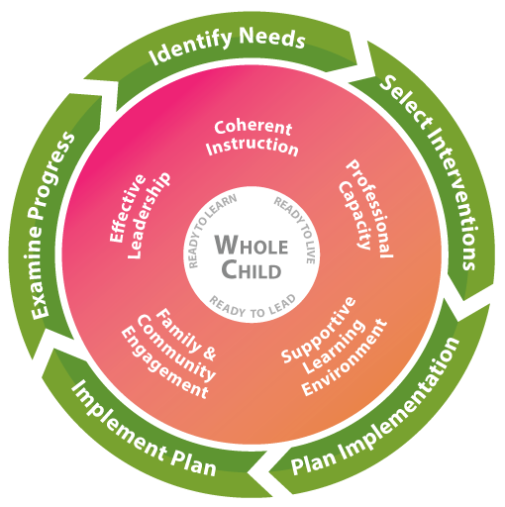
Georgia’s Systems of Continuous Improvement
GaDOE has adopted the Georgia Systems of Continuous Improvement as a methodology for supporting districts and schools. This methodology focuses on improving districts/schools’ systems.

Slide 7
GaDOE Updates: FY19 Consolidated LEA Improvement Plan (CLIP)
The GaDOE CLIP integrates the required federal application requirements for all federal programs within the systems framework and includes a data analysis and planning component
For FY19, LEAs have selected one of three FY19 CLIP options to submit to GaDOE
Online SLDS Option
Offline PDF Option will be fazed out in FY20
Streamlined-CLIP
CLIPs will be submitted through the SLDS now through July 31st
Submitted CLIPs will be reviewed collaboratively by one of the 16 GaDOE CLIP teams (each team has representatives from all federal programs). Ten business day turn-around
Once CLIPs are approved, federal budgets may be submitted

Slide 9
GaDOE Updates FY19 Preliminary Allocations
Superintendents will receive a preliminary estimate of their FY19 federal allocations during the month of May
Congress has not allocated the final FY19 federal programs fund, so the May allocations are only preliminary estimates
These estimates can be used for planning purposes as districts/schools begin collaborating on their district and school level improvement plans and budgets
Title II, Part A will be funded in FY19 - YEAH
Title IV, Part A received a 125% increase – THANK YOU

Slide 10
GaDOE Updates Funding Flexibility
It is the goal of the GaDOE to ensure LEAs have the ability to maximize the use their funds to meet the needs of the students being served.
Braiding/Coordination of Funds
Financial resources from several individual funding streams coordinated by all stakeholders to support a single initiative,
Each individual award maintains its specific identity
While braiding is encouraged, the funds still have to meet the intent and purpose of each individual funding stream

Slide 11
GaDOE Updates Funding Flexibility
It is the goal of the GaDOE to ensure LEAs have the ability to maximize the use their funds to meet the needs of the students being served.
Transfer/Coordination of Funds (ESEA Section 5103)
LEAs may transfer up to 100% of funds from Title II and Title IV to Title I-Part A, Title I-Part C, Title I-Part D, and Title III-Part A.
Funds that are transferred must follow the statutes and guidance of the program to which they are transferred
LEAs must still meet the requirements of the original program
Once funds are transferred, they cannot be moved back

Slide 12
GaDOE Updates Funding Flexibility
It is the goal of the GaDOE to ensure LEAs have the ability to maximize the use their funds to meet the needs of the students being served.
Consolidation of Federal Funds - Fund 400 (ESEA Section 8203)
This is the traditional schoolwide use of funds
LEAs that follow proper methodologies to allocate funds to the school level, may consolidate school level federal funds in order to meet the needs of the school/district
Only schoolwide Title I schools are eligible to do this
The intents and purposes of the law must still be met for each federal program consolidated

Slide 13
GaDOE Updates Funding Flexibility
It is the goal of the GaDOE to ensure LEAs have the ability to maximize the use their funds to meet the needs of the students being served.
Consolidation of State, Local, and Federal Funds – Fund 150
These consolidated funds become local funds and lose federal requirements (Procurement, inventory, UGG)
Allocate federal funds to Title I Schoolwide schools
The consolidated funds must still meet intent and purposes of federal programs consolidated
School leadership maintains control of how funds are spent
Contact Shaun Owen (sowen@doe.k12.ga.us) at GaDOE for more details

Slide 14
GaDOE Updates Funding Flexibility
It is the goal of the GaDOE to ensure LEAs have the ability to maximize the use their funds to meet the needs of the students being served.
Consolidation of Administrative Funds - NEW
LEAs are allowed, with GaDOE approval, to consolidate costs associated with the administration of those federal ESEA grant funds from several programs
One benefit - could pay for LEA Federal Program Director to cover all federal programs without having to be split funded
An LEA must notify GaDOE (federalprograms@doe.k12.ga.us) by July 1 if they are seeking permission to consolidate administrative funds for the upcoming fiscal year
GaDOE will then contact the LEA with next steps

Slide 15
GaDOE Resources
Please visit our Federal Programs website at:
http://www.gadoe.org/School-Improvement/Federal-Programs/Pages/default.aspx

Slide 16
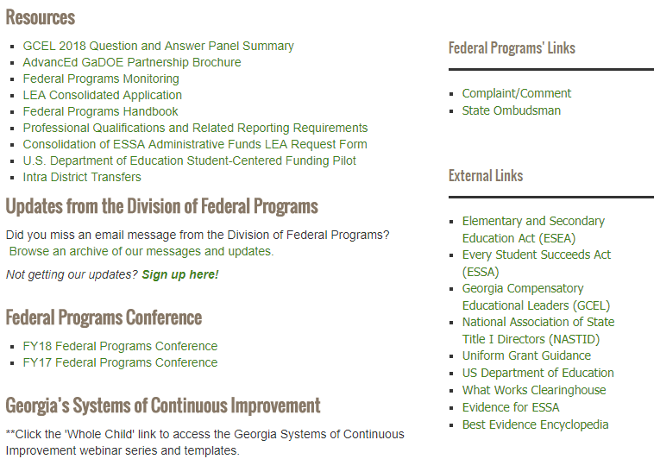
GaDOE Updates State Resources

Slide 17
Federal Programs Handbook

Slide 18
Required Written Procedures
& Required Documentation

Slide 19
GaDOE Updates Federal Laws and Requirements
Statutes
ESEA/ ESSA & Consolidated Appropriations Act
USDE Non-Regulatory Guidance
USDE Policy Letters
EDGAR
2 CFR Part 200 Uniform Administrative Requirements
34 CFR Part 76 State Administered Programs
34 CFR Part 81 General Education Provisions Act (GEPA)
Notes:
Talking Points:
In FY17 Districts/LEAs are required to comply with the of ESEA/ NCLB statute and some provisions in ESEA/ESSA.
Remember that FY17 is a transition year as we move from NCLB to ESSA, so some portions of ESSA will not go into affect until FY18.

Slide 20
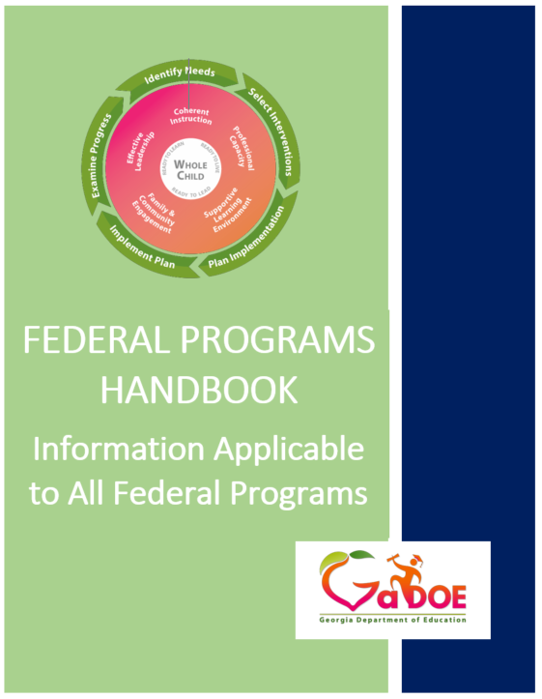
GaDOE Updates 2 CFR Part 200 Requires Procedures pp. 23-24 and 27
Written policies and procedures are required!
Written Cash Management Procedure - §200.302(b)(6) and §200.305
Written Allowability Procedures - §200.302(b)(7)
Written Procedures for managing equipment § 200.313(d)
Written Conflicts of Interest Policy - §200.318(c)
Written Procurement Procedures - §200.319(c)
Written Method for Conducting Technical Evaluations of Proposals and Selecting Recipients - §200.320(d)(3)
Written compensation and leave policies §200.430
Written Travel Policy - §200.474(b)
Procedures for Checking Suspension and Debarment – 2 CFR § 180.25(a)

Slide 21
GaDOE Updates Procurement with Federal Funds pp. 24-26
Four Methods of Procurement with Federal Funds:
Micro-Purchase
Small Purchase
Sealed Bids
Competitive Proposals
Your procedures should outline your processes for each of these procurement methods

Slide 22
GaDOE Updates Procurement with Federal Funds p. 24-26
Procurement by Micro-Purchases - the acquisition of supplies or services,
the aggregate dollar amount of which does not exceed the micro-purchase threshold of $3,500.00
LEAs should calculate the aggregate dollar amount for each purchase order of supplies or services by federal program
Must distribute micro-purchases equitably among qualified suppliers.
May be awarded without soliciting competitive quotations if the non-Federal entity considers the price to be reasonable.

Slide 23
GaDOE Updates Procurement with Federal Funds p. 24-26
Procurement by Small Purchase - those relatively simple and informal procurement methods for securing services, supplies, or other property:
That do not cost more than the simplified acquisition threshold (§200.88) of $150,000.00
Price or rate quotations must be obtained from an adequate number (at least 2) of qualified sources
Good Practice: Keep documentation with voucher packet

Slide 24
GaDOE Updates Procurement with Federal Funds pp. 24-26
Procurement by Sealed Bids - formal advertising
Purchases greater than $150,000.00
Bids are publicly solicited
A firm fixed price contract (lump sum or unit price) is awarded to the responsible bidder whose bid is the lowest in price, and conforms to all the material terms and conditions of the invitation for bids (§200.319)
Sealed bids must conform to the conditions and requirements outlined in 2 CFR §200.319

Slide 25
GaDOE Updates Procurement with Federal Funds pp. 24-26
Procurement by Competitive Proposals - (§200.319)
Normally conducted with more than one source submitting an offer
Either a fixed price or cost-reimbursement type contract is awarded
It is generally used when conditions are not appropriate for the use of sealed bids
Contracts are awarded to firm whose proposal is most advantageous to the program with price and other factors considered
If this method is used, 2 CFR §200.319 lists several requirements that must be followed

Slide 26
GaDOE Updates Procurement with Federal Funds pp. 24-26
Procurement by Noncompetitive Proposals - solicitation of a proposal from only one source
May be used only when one or more of the following circumstances apply:
a. The item is available only from a single source;
b. The public emergency for the requirement will
not permit a delay resulting from competitive solicitation;
c. The Federal awarding agency or pass-through entity expressly
authorizes noncompetitive proposals in response to a written
request from the non-Federal entity; or
d. After solicitation of a number of sources, competition is
determined inadequate.
Sole Sourcing Should Be Limited
Sole source letters from vendors are problematic

Slide 27
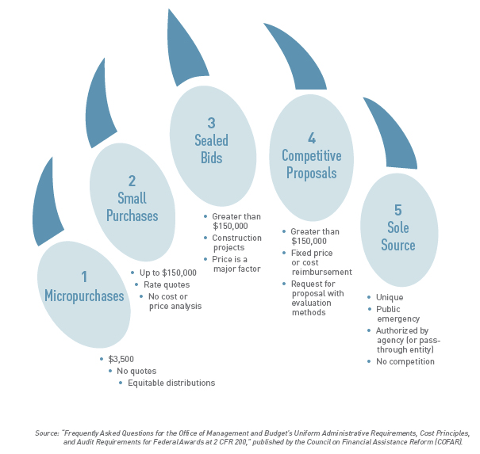
The Procurement CLAW

Slide 28
GaDOE Updates Procurement with Federal Funds p. 26
Statewide Contracts – Georgia Department of Administrative Services
LEAs may utilize Georgia’s statewide contracts for the procurement of supplies and services
LEAs should follow their own internal processes for using these statewide contracts as administered by the Georgia Department of Administrative Services (DOAS)
LEAs are still responsible for ensuring that all federal regulations are followed when utilizing these contracts

Slide 29
GaDOE Updates
Document, Document, Document…
Common Expenditures | Source Documentation | Common Expenditures | Source Documentation
Travel | Activity Agenda/ Materials Travel Form (mileage, meals) Teacher Name, Content, Location Hotel Receipts | Stipends | Time and Effort Activity Agenda/ Materials Sign-In Sheet (Roles) Teacher Name, Content, Location
Substitutes | Time and Effort Activity Agenda/ Materials Teacher Name, Content, Location | Supplies and Equipment | Detailed Purchase Order/ Invoice Associated Activity Price Quote if Applicable
Registration/ Dues and Fees | Agenda/ Registration Description Purchase Order | Contracts/ Purchased Services | Contract Scope of Work/ Deliverables Receipt of Deliverables Price Quote if Applicable
Personnel | Job Description Time and Effort | Implementation Trainings and Meetings | Activity Agenda/ Materials Sign-In Sheet (Roles)
P-Card/ | Statement Corresponding Documentation to Determine Allowability | Journal Entries | Detailed Documentation to Determine Allowability
Notes:
Including, but not limited to...
Talking Points:
We are often asked what good source documentation looks like.
These are simply examples for common expenditures.
Each LEA must decide what they believe helps establish allowability.
If you have questions, don’t guess – ask your Program Specialist.

Slide 30
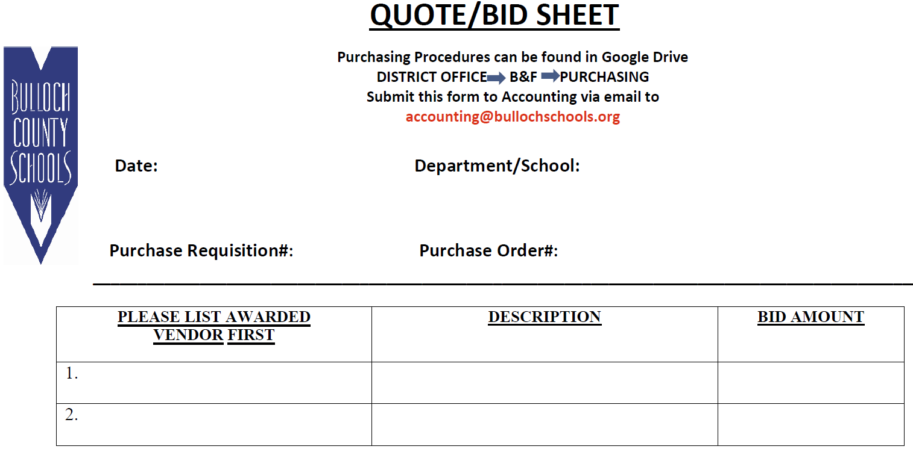
Sample: Procurement Documentation From a District

Slide 31
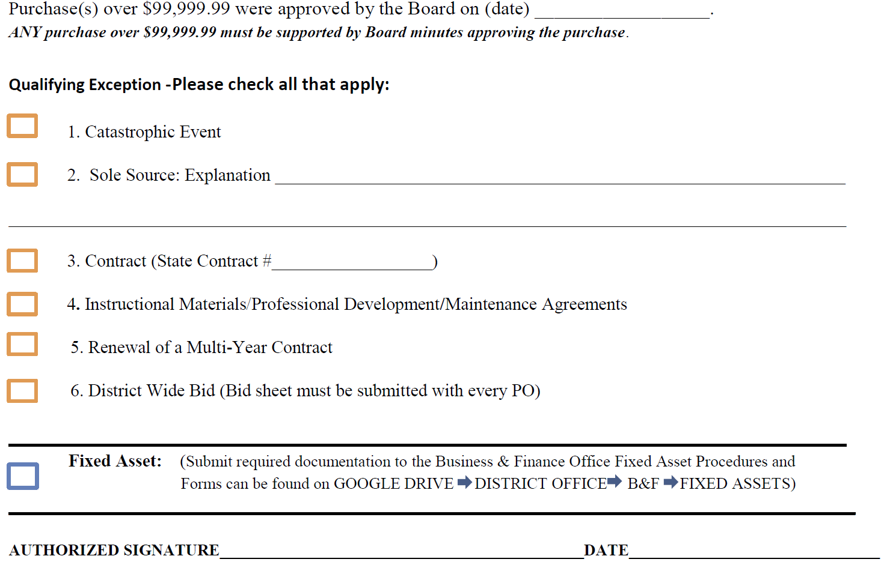
Sample: Procurement Documentation From a District

Slide 32
GaDOE Updates Drawdown of Federal Funds pp. 33-36
The Uniform Administrative Requirements, Cost Principles, and Audit Requirements for Federal Awards (also known as the Uniform Grant Guidance or UGG) requires all Federal programs to have written procedures to implement the requirements for payments of Federal funds.
(2 CFR 200.302)

Slide 33
GaDOE Updates Drawdown of Federal Funds pp. 33-36
All disbursements to LEAs will be reimbursement for all allowable incurred Federal program expenditures
A best practice for an LEA is to include in their drawdown procedures and practices a copy (paper or electronic) of the complete expenditure detail report that directly relates to each DE0147 drawdown request
Each LEA is required to document their procedures for cash management compliance of Federal programs (2 CFR 200.302)
Document the internal controls in place to ensure there is appropriate review and authorization of the cash drawdown by someone other than the individual requesting the drawdown
Remember, the federal program must expend at least 85% of its allocation in order to carryover unexpended funds

Slide 34
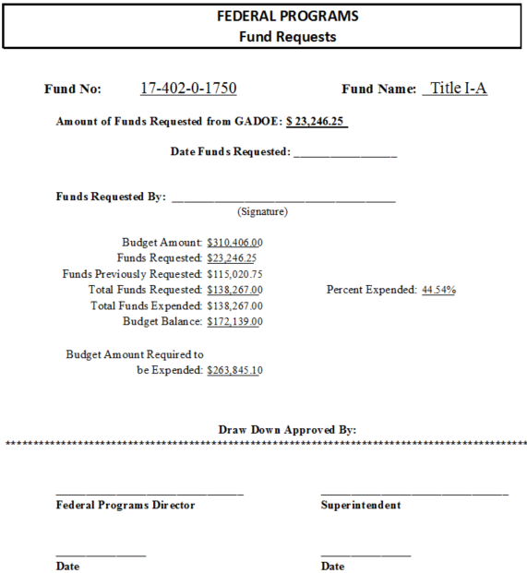
Example of a good Procedure and Practice

Slide 35
GaDOE Updates Example of a good Procedure and Practice Part 1

Slide 36
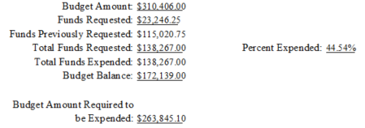
GaDOE Updates Example of a good Procedure and Practice Part 2

Slide 37
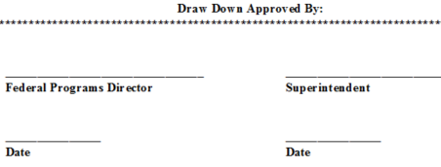
GaDOE Updates Example of a good Procedure and Practice Part 3

Slide 38
GaDOE Updates Supplement Not Supplant (SNS) pp. 46-50
SNS Requirements for Title II & Title IV, Part A Funds made available under this title shall be used to supplement, and not supplant, non-Federal funds that would otherwise be used for activities under this part.
SNS Requirements for Title III & Title IV, Part B & Title V, Part B Federal funds made available under this subpart shall be used so as to supplement the level of Federal, State, and local public funds and in no case to supplant such Federal, State, and local public funds

Slide 39
GaDOE Updates Supplement Not Supplant pp. 46-50
Presumptions of Supplanting In the following instances, it is presumed that supplanting has occurred if:
The LEA used Federal funds to pay for services/activities that were required under other Federal, state or local laws
The LEA used Federal funds to pay for services/activities that were provided with non-Federal funds in the prior year

Slide 40
GaDOE Updates Supplement Not Supplant – Title I pp. 46-48
Title I Requirements ESSA Section 1118(b)(1)
The statute requires an SEA or LEA to use Title I funds only to supplement the funds that would, in the absence of those Title I funds, be made available from State and local sources for the education of students participating in Title I programs, and not to supplant such funds.

Slide 41
GaDOE Updates Supplement Not Supplant – Title I pp. 46-48
According to the statute, no LEA shall be required to…
Identify that an individual cost or service supported with Title I funds is supplemental; or
Provide Title I services through a particular instructional method or in a particular instructional setting in order to demonstrate compliance.
The special rule applies to both schoolwide programs and targeted assistance programs.
1118(b)(3)
Because the LEA must have a methodology in place!!!!!!

Slide 42
GaDOE Updates Supplement Not Supplant – Title I pp. 46-48
Demonstration of Compliance
LEA must demonstrate that the methodology used (RAMP) to allocate State and local funds to all its schools is implemented
Ensures that each Title I school receives ALL of the State and local funds it would otherwise receive if it were not receiving Title I funds (1118(b)(2))
RAMP must be in place by July 1, 2018
Webinar with guidance on preparing the RAMP will be provided on May 16th at 9:00 am

Slide 43
GaDOE Updates Supplement Not Supplant – Title I pp. 46-48
An LEA has significant flexibility in adopting a methodology to meet the new supplement not supplant requirement. The methodology must…
Allocate state and local funds to ALL schools in the LEA in an equitable manner
Equitable does not mean Equal
An LEA must be able to demonstrate compliance—i.e., that it has implemented its methodology
RAMP will be “checked for implementation” during monitoring
Upload RAMP to Attachments tab in Portal
Title I Specialists will “review” RAMP when submitted

Slide 44
Things to consider when developing your RAMP
GaDOE Updates Supplement Not Supplant – Title I pp. 46-48
What state and local funds are available?
State QBE
Local Tax Revenue
Other
How many schools and programs are in your system
All schools do not require the same resources/funding
Consider BOE office state/local funding needs first
Resource Allocation Plan cannot exceed available state/local funds

Slide 45
GaDOE Updates
Suspension and Debarment
p. 28
Non-federal entities are subject to the non-procurement debarment and suspension regulations
Executive Orders 12549 and 12689, 2 CFR part 180
These regulations restrict awards, subawards, and contracts with parties that are debarred, suspended, or otherwise excluded from or ineligible for participation in Federal assistance programs or activities.
2 CFR §200.213

Slide 46
GaDOE Updates Suspension and Debarment p. 28
Any contract or subcontract expected to equal or exceed $25,000 must be checked against the System for Award Management (SAM) for suspension or debarment (includes contracted tutors)
www.sam.gov
Evidence of the verification can be in the form of a date/time stamped print screen or other digital method that is readily available
What are your procedures

Slide 47
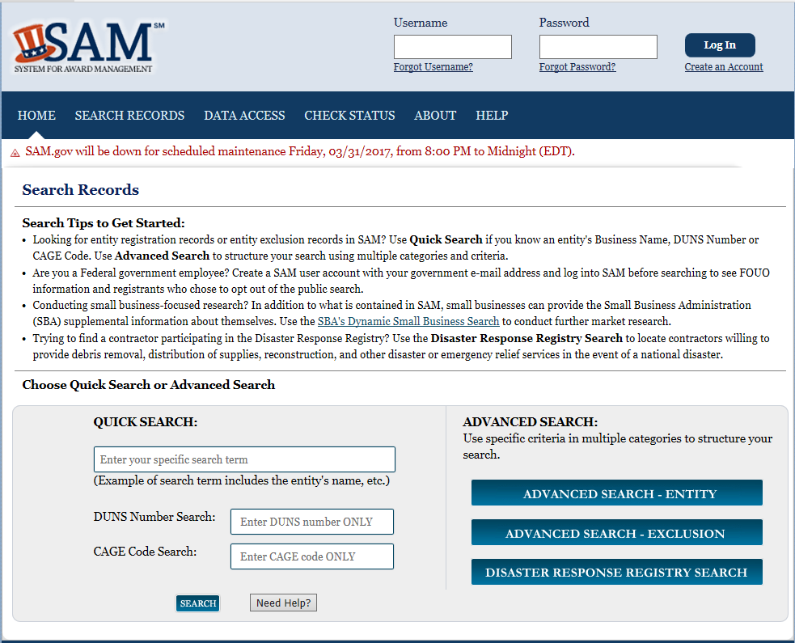
GaDOE Updates Suspension and Debarment p. 28

Slide 48
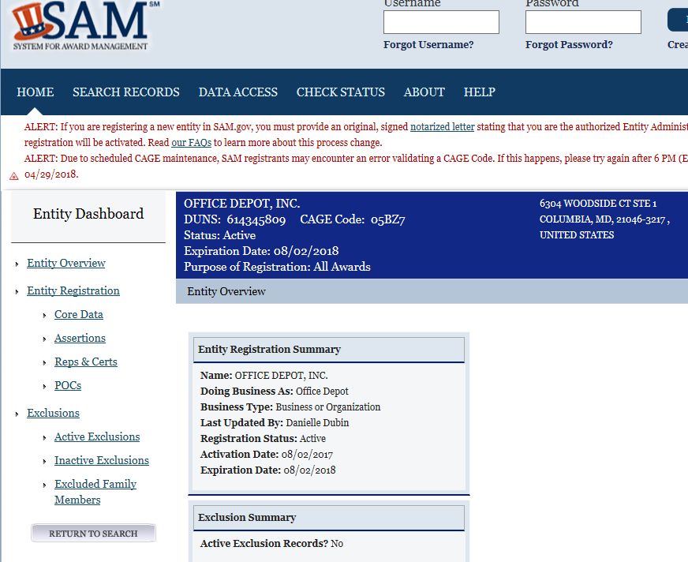
GaDOE Updates Suspension and Debarment p. 28
DOCUMENTATION Print out this report, sign, and date it if not already on form.

Slide 49
GaDOE Updates Completion Reports
p. 32-33
Each federal program’s completion report is reviewed during monitoring
Auditors review annually, especially your Title I, Part A’s report (due to large allocation to LEA)
Keep either paper or electronic copy of your general ledger or other document used to process your completion reports
Financial Review’s website has instructions for processing the completion reports
Complete Sub-Grant completion reports as well

Slide 50
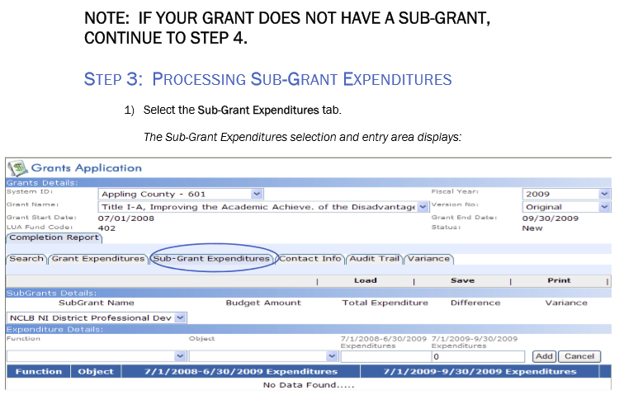
GaDOE Updates Completion Reports
Beginning with the FY18
Completion Reports,
Title I, Part A will
NO LONGER REQUIRE
LEAs to process its Title I, Part A
Sub-Grant part of the
Completion Report!

Slide 51
Questions

Slide 52
Dr. Ken Banter
Title I, Part A Program Manager
Office of Federal Programs
(404) 673-2372
kbanter@doe.k12.ga.us

