Slide 1
GAINS 2018
GaDOE
May 3, 2018
Amy Rowell – Financial Review

Slide 2
AGENDA
Amended FY 2018 Budget
Initial FY 2019 Budget
2018 Legislation
Salary Schedule
GASB 75 – OPEB Liability
Medicaid Reimbursement
Transparency/ESSA/FESR
Chart of Accounts Issues
Financial Reporting
Consolidated Administration Initiative
GASB 68
Regional Workshops

Slide 3
FY 2018 Mid-Term Adjustments

Slide 4
AFY 2018
HB 683 Signed by Governor – March 9, 2018
Funded enrollment growth - $85,867,907
Funded Hold Harmless - $15,963,050
Initial FTE – 1,744,714
Mid-Term FTE – 1,751,239
Charter System Supplement Enrollment Growth - $155,075
State Commission Charters - $16,367,387 (includes 3% reduction to Commission)
Special Needs Scholarship (SB10) Reduction – ($1,006,923)
Notes:
Charter System grant increased due to all charter systems approved by July 1, 2016.

Slide 5
AFY 2018
Transportation
  Amended the transportation allotment to provide an additional $1,760,918
  Increase funds to purchase 204 school buses statewide
  $15,750,000
  Added to the Business and Finance Administration Budget
  Not bonds
  Will be awarded as a grant through GAORS
  Use Bus Bond Program Code
  Will be paid on specified date (to be determined)
  Completion Report required
Notes:
The additional transportation allotment is not an increase in funds, but an increase in the initial allocation to school districts based on need. Determined by our transportation department. $77,000 per bus.

Slide 6
AFY18
CTAE Middle School Computer Coding Program
  $25,000 Per School
  FY 18 Mid-Term Budget
  Accept Grant Applications through June 1st
  Funds must be awarded by June 30th
  Will have a set period to spend funds
Notes:
$500,000

Slide 7
FY 2019 QBE and Other State Grants

Slide 8

AUSTERITY

Slide 9
Initial FY 2019 QBE
HB 684 – Scheduled to be signed May 2, 2018
Austerity Eliminated - $166,769,846
Enrollment Growth and T&E - $112,320,693
TRS Increase 16.81% to 20.90% - $289,903,398
FTE – 1,751,239
Reduction in Math and Science – ($1,247,818)
Nursing Increase - $51,233
Charter System Supplement - $46,644
  Adjusted for Increased FTEs
State Commission Charter Schools - $4,758,023
Notes:
No increase in the Salary Schedules in the FY 19 budgets. 0.38% in enrollment growth. FTE 1,746,203 to 1,751,239
Nursing - Governor’s Budget cut funding for nurses by $580,542, the House wanted to increase funding. The FTEs for nursing positions did not increase. The salary allotted did not increase. The operational funds for supplies increased and is prorated among all districts.
Math and Science saw a huge reduction in qualified teachers earning the supplement. Last year’s FY 18 bill decreased by around $350K, the $1.2M decrease is much greater.

Slide 10
Initial FY 2019 QBE
Decreased funds for the TRS State Support - ($1,039,840)
O.C.G.A. §47-3-63
Four positions covered by the State Support
7% of each category or 1 employee
Notes:
We did such a good job in monitoring what you all were reporting……they cut our budget.

Slide 11
Initial FY 2019 QBE
Equalization Increase - $30,754,004
  Overall allotment - $615,316,420
Local Five Mill Share Increase - $95,230,942
  Overall allotment decrease due to LFS - $1,872,395,263

Slide 12
Initial FY 2019 QBE
House Recommended to move Pupil Transportation out of QBE
Still funding the same, but Pupil Transportation will have its own line item in the budget
Transportation Funds - $131,980,741
Increase of funds due to increase student enrollment - $903,377
Bus bonds of $15,000,000
Additional bonds of $1,250,000 for alternative fuel school buses
Notes:
The $903,377 will probably be allotted as an amendment. Will not be available to allocate effective July 1.

Slide 13
Initial FY 2019 QBE – Categorical Grants
Sparsity – Updated FTEs and calculation for TRS – Reduction of Funding – ($259,193)
Residential Treatment Centers – Updated FTEs – Reduction in Funding – ($128,575)
  State Preschool Disabilities Grant –
    $1,056,333 for TRS increase
    $735,961 for enrollment growth and T&E

Slide 14
FY 19 RESAs
RESAs – Mental Health Awareness Training - $1,600,000
TRS increase - $134,984
Notes:
The RESA mental health awareness training grant will more than likely be a contracted statewide instead of individually with each RESA.

Slide 15
QBE Military Counselors
Appropriated line item in the budget
$445K for FY 19
3 Year Pilot Project
No more than $700K annually for 3 years
Military Flagship Friendly School
Funding allocated the same as last year.

Slide 16
Equalization – 2019
Fully Funded for FY 2019
  Formula Calculated a total amount of $615,316,420
  Increase in funding of $30,755,000 (5.2% increase)
State Benchmark $149,240 per FTE in FY 2018 to $144,820.85 per FTE in FY 2019
32 districts decreased equalization funding
54 districts had no change (i.e., no funding in either year)
94 districts increased equalization funding
Above the benchmark, did not receive funding
Below the benchmark, received funding
Notes:
You may be wondering…..hey…..our LEAs wealth per FTE is well below the benchmark for the state……why did we lose funding? Maybe your district increased wealth per FTE by either increased property values or decreasing FTES, so the gap to be equalized was less.
Or you may have increased……you could have increased because you saw a drop in your equalized earnings. Or a significant enrollment increase……

Slide 17
Bonds – 2019
Capital Outlay – Regular - $207,195,000
Capital Outlay – Regular Advance - $12,075,000
Capital Outlay – Low Wealth - $31,620,000
Capital Outlay – Additional Project Specific Low-Wealth - $8,660,000
Ag Ed Equipment - $2,985,000
Vocational Equipment - $6,420,000
School Facility Safety Grants - $16,000,000
Notes:
We do not yet know how the safety facility grants will be disseminated. Please stay tuned….

Slide 18
State Health Benefit Plan
Employer Contributions
  Certified Employees - $945 PMPM
  Non-certified Employees - $945 PMPM
    Increase from $846.20 PMPM
    Effective January 1, 2018
No change for FY 2019
SHBP rolling out new phone system May 15th
SHBP 2018 Benefit Professional Conference August 6-8 – Jekyll Island

Slide 19
TRS
Employer Rates
  FY 2018 – 16.81%
  FY 2019 – 20.90%
Employee Rates
  FY 2018 – 6%
  FY 2019 – 6%

Slide 20
Allotment Sheets
AFY18 Allotment Sheets were posted on March 29, 2018
AFY18 Site Level Allotment Sheets were posted on April 11, 2018.
FY 18 Accrual Sheets pending.
FY19 Allotments Sheets are scheduled to be posted, as Governor expected to sign this week.

Slide 21

Legislation

Slide 22
FY 2016 – HB 65
Amended O.C.G.A. §20-2-167.1
2 public meetings before final adoption of budget
Public meetings must be advertised
Can be during any other meeting as long as advertised and meeting is opened for public comment
Removed FMGLUA requirement to advertise budget since not included in 20-2-167 or 20-2-167.1
Notes:
We have updated FMGLUA to remove the requirement to advertise the budget in the paper. The intent of this law

Slide 23
Transparency Dashboard – State Board Rule 160-5-2-.21 Amended 3/22/18, Effective 4/11/18
Template to be ready by January 1, 2018
  Updated State Board Rule 160-5-2-.21
Disclosure of information by October 2018
Notes:
Amended Effective March 20, 2018

Slide 24
Transparency Dashboard – State Board Rule 160-5-2-.21 Amended 3/22/18, Effective 4/11/18
(h) The Department will provide all financial and budgetary information for each school district, state charter school, and each school within each school system, as provided by each local unit of administration, on its public facing website, to provide transparency of financial information to the greatest extent practicable.
1. In addition to the information required by this Rule, the Department will provide certain analyses of data and links to other disclosures as prescribed by law.

Slide 25
Transparency Dashboard – State Board Rule 160-5-2-.21 Amended 3/22/18, Effective 4/11/18
(i) Each school district, state charter school, and each school within each school system will provide a link on their public facing websites to the Department’s public facing website in which the financial and budgetary information is disclosed.

Slide 26
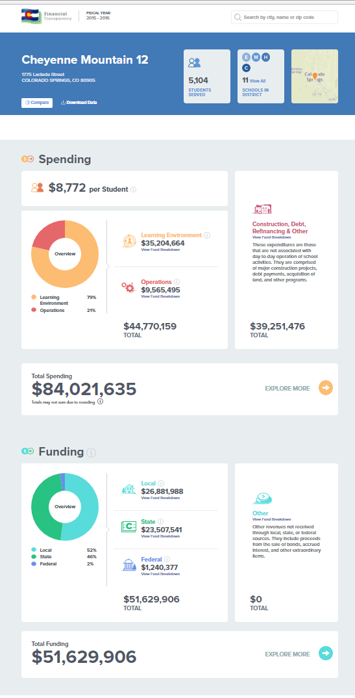
Transparency –Nationwide
Colorado Department of Education

Slide 27
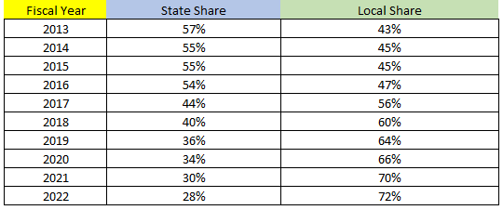
FY 2018 - HB 329 – Sent to Governor April 6, 2018 – Effective July 1, 2019
TAVT as passed in FY 2013:
Included provisions for increasing or decreasing depending on if target collections were met.
Also included a “true up” provision for the 2012 motor vehicle ad valorem amount.

Slide 28

FY 2018 - HB 329 – Sent to Governor April 6, 2018 – Effective July 1, 2019
TAVT as passed in FY 2018:
Portion of Local Share, beginning in FY 2020, for school districts is 49%. (49% of the local portion 65%)
The “true up” to the 2012 values is eliminated.

Slide 29
FY 2018 - HB 329 – Sent to Governor April 6, 2018 – Effective July 1, 2019
Changed manner for determining fair market value of motor vehicles subject to the tax
Tax based on the total base payments pursuant to the lease agreement

Slide 30
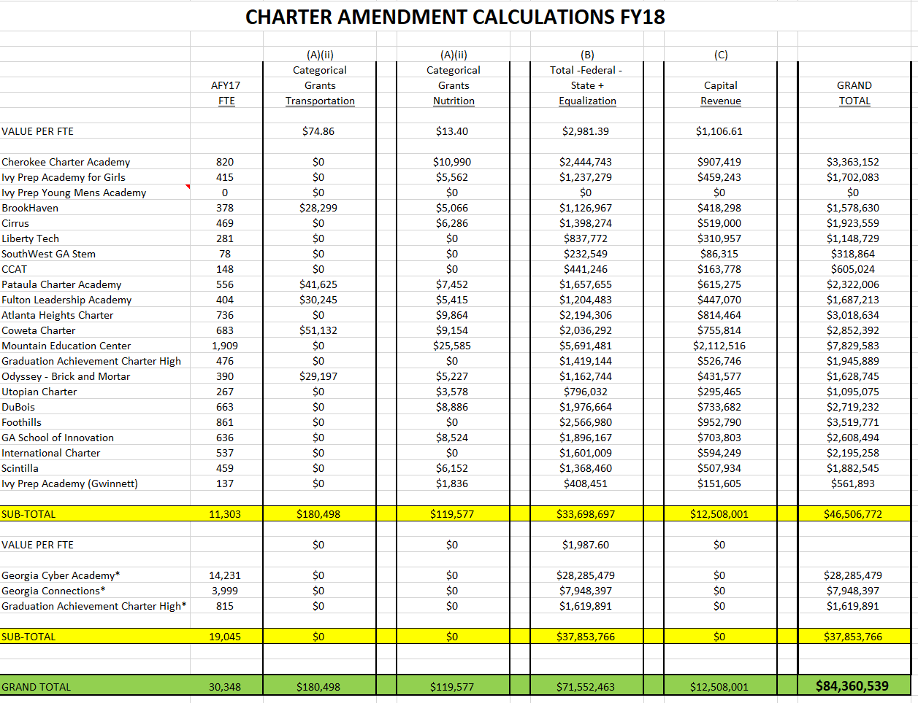
FY 2018 - HB 787 – Sent to Governor April 4, 2018

Slide 31
FY 2018 - HB 787 – Sent to Governor April 4, 2018
Requires state charter schools to be served by RESAs (and requires charters to be a member)
GLRS centers to serve all school districts and state charter schools
Psychoeducational Networks to serve all school districts and state charter schools.
RESA instructional care teams to serve state charter schools

Slide 32
FY 2018 - HB 787 – Sent to Governor April 4, 2018
Amends the calculation of the charter school supplement – allots the state-wide average of the total revenues less federal revenues less state revenues other than equalization per full-time equivalent for all systems.
If the average of the net revenues for the local school systems in the state charter’s attendance zone is less than the state-wide average, the charter will receive the greater of the school systems average or the lowest five school systems’ in the state average.

Slide 33
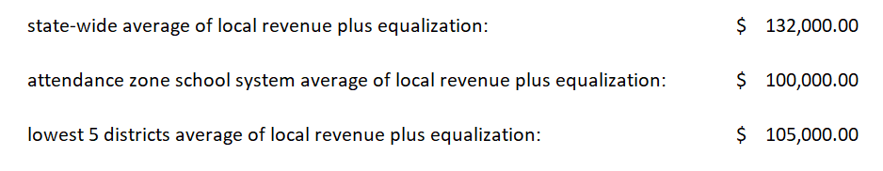
FY 2018 - HB 787 – Sent to Governor April 4, 2018
In this example, which amount would be allotted to the state charter school?
Notes:
$105,000. Attendance area average is less than state-wide average……

Slide 34
FY 2018 - HB 787 – Sent to Governor April 4, 2018
Amends the calculation of capital revenue to the greater of the state-wide average or the average of the local school system attendance zone for brick and mortar state charter schools.
Virtual charters will receive 25% of the state-wide average if school provides technology equipment.

Slide 35
FY 2018 - HB 787 – Sent to Governor April 4, 2018
Funds projections of increased enrollment if the expected increase is 2% or greater.
Currently only new school projections or new grade levels are funded with projection.
Initial funding shall also include projections for training and experience earnings.
New grants for the purpose of replicating high-performing charter schools.
Notes:
Those grants will be determined by our Policy Division…..not sure how those grants will be awarded to the state charters.

Slide 36
Salary Schedule

Slide 37

Local LEA Salary Schedule
What salary schedule has your local board adopted?
If the local schedule includes the state salary + local supplement, the salaries are required to be split between the state and local QBE program codes.
If the local schedule includes just one dollar amount per category (step, certification, level, etc.), the salaries should be reported in total to the state QBE program codes.
Notes:
It’s up to the school district to make this decision. But if your locally adopted salary schedule STILL REFERENCES the state salary schedule, then you are required to split the salary expense. The House Budget Office requested this detail for FY 2017……and wants it for FY 2018. Even though you don’t have to follow it, we still expect to know what salaries you are paying with state funds versus paying with local funds.

Slide 38

GASB 75 – Accounting and Financial Reporting for Postemployment Benefits Other Than Pensions (OPEB)

Slide 39

GASB 75
Only 4 Entries
Does not include any State Support Entries
Contributions must be provided by DCH – no adjusting entries for variances in Contributions
Subsequent Period Contributions will not be in the original packet. Will be received at a later date.

Slide 40
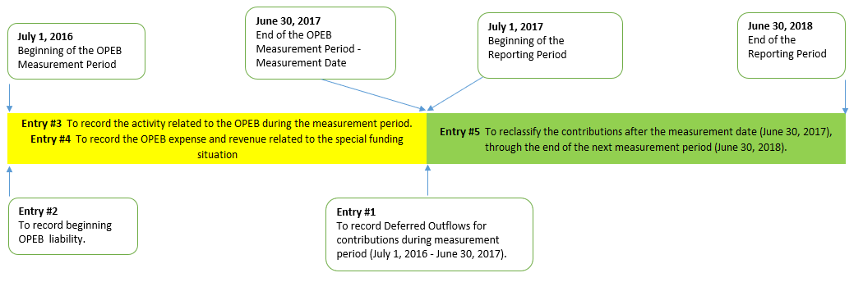
GASB 75 – measurement period versus reporting period
Notes:
Timeline for GASB 75

Slide 41
GASB 75
Why are Contribution Amounts provided by DCH instead of by LEA?
Entries are based on Contributions to School OPEB Fund. LEAs pay Employer Contributions that fund current plan expenses, administrative expenses, and contributions to School OPEB Fund. LEA cannot determine separate amounts based on billing by DCH.

Slide 42
Resources Available on Financial Review’s webpage
For Fiscal Year 2018
  DCH SHBP Allocations for GASB 75 School OPEB Entries
  FY 18 GASB 68 Allocation Worksheets
  Instructions for Posting the Net OPEB Liability – 2018
  2018 SHBP Sample OPEB Packet for LEAs
Packets provided by DCH. Check with your HR or Payroll Coordinator. DCH sends all communications to their appropriate contact!

Slide 43
Medicaid Nursing Reimbursements

Slide 44
Medicaid Reimbursement
Looking at program to seek reimbursement for nursing services provided by school districts
Services provided by licensed nurses DIRECTLY to students
Will need to capture salaries/benefits for licensed nurses separately from the generalized nursing services and operating costs funded by QBE (Program Code 1500)
More information coming soon

Slide 45
Every Student Succeeds Act
(ESSA)

Slide 46
ESSA – School Level Reporting
“The per-pupil expenditures of Federal, State, and local funds, including actual personnel expenditures and actual nonpersonnel expenditures of Federal, State, and local funds, disaggregated by source of funds, for each local educational agency and each school in the State for the preceding fiscal year.”

Slide 47
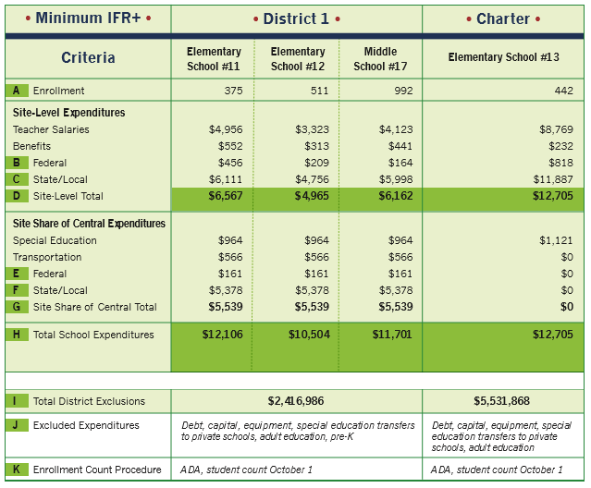
ESSA – School Level Reporting – Edunomics Lab
EXAMPLE OF POSSIBLE REPORT

Slide 48
ESSA – Per Pupil Expenditures Per FESR
Includes Site Level Expenditures, Site Level Excluded Expenditures, Share of Centralized Expenditures, Total School Expenditures, and Total Excluded School Expenditures.
The Expenditure Calculation for the Star Rating will meet the current requirements for ESSA Reporting

Slide 49
Chart of Accounts Updates

Slide 50
Function 2213
Code costs to same functional category as employee’s salary
NO
Is the professional development cost for instructional staff?
YES
Code costs to Function 2213

Slide 51
Chart of Accounts
Survey sent in April, 2018
Special Education, Non-Instructional Program Code?
Head of Component Object Code?
Local Charter School Fund for School Activity Accounts?
Separate Fund for OPEB?

Slide 52
Chart of Accounts
Special Education, Non-Instructional Program Code
Why not 2011?
2011 is technically a revenue program code. This is how the QBE special education dollars are paid. This program code is a direct offset of instructional expenditures defined in 2021, 2031, 2041, 2051, 2061

Slide 53
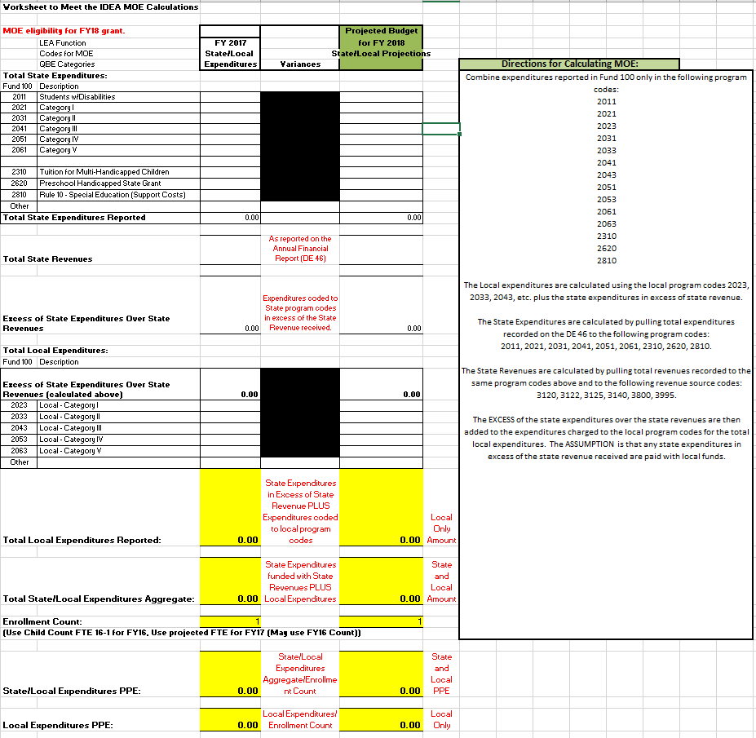
Chart of Accounts – Special Ed MOE

Slide 54

Chart of Accounts
Fund 422 – Even Start
Fund 370 – Exceptional Growth Capital Outlay
Notes:
These funds are reported on the Web Report, Excluded on the FESR Rating. Let’s stop using them……

Slide 55
Chart of Accounts
School Activity Accounts
Expenditure Activity MUST be reported by school code, not Central Office.
Otherwise, the Transparency Data associated with HB 139 will report principal activity at the Central Office Level.

Slide 56

Chart of Accounts
MORE SURVEYS!!!!!
Function 1000
Function 2300/2230
Notes:
Sending out today!!!! Let us know about some of the code relationship rationalizations you have. I think this will help us with training…….

Slide 57

Financial Reports and Final Statements

Slide 58
Deadlines
July 9, 2018
Open the Portal for Year End Transmissions
September 21, 2018
FY 2018 Financial Analysis Report
FY 2018 Final Budget Report
FY 2017 Initial Budget Report
December 31, 2018
Completed Financial Statements
  Include Exhibits, Schedules, Notes to Financial Statements, MD&A (if preparing one)

Slide 59
DE 46 Updates
Warning Requiring Explanation if On-Behalf Payments are not posted to DE 46
  Will NOT accept warning explanation unless we are showing no On-Behalfs for the LEA
DE 46 upload is still in old location. Use the Error and Warning Reports in old location. Reports are in NEW location.

Slide 60
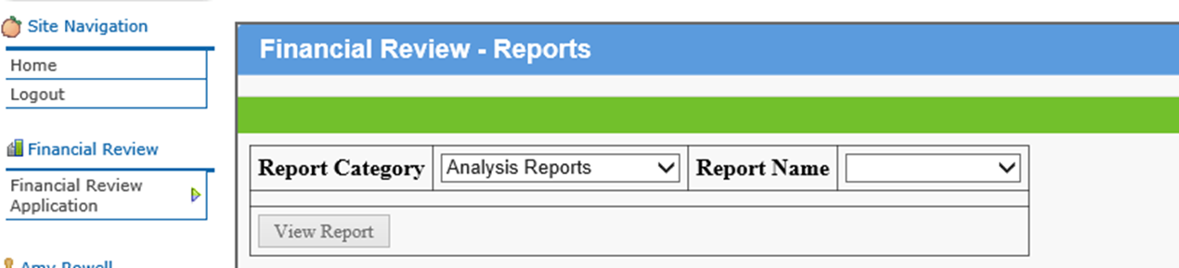
GaDOE Portal
Financial Review Application
  Analysis Reports
    Actual Analysis – DE 46 Actual Analysis Report
    Budget Analysis – DE 46 Budget Analysis Report – once selected, then choose Initial or Final
    Actual SignOff – Superintendent Report
    Budget SignOff – Superintendent Report

Slide 61
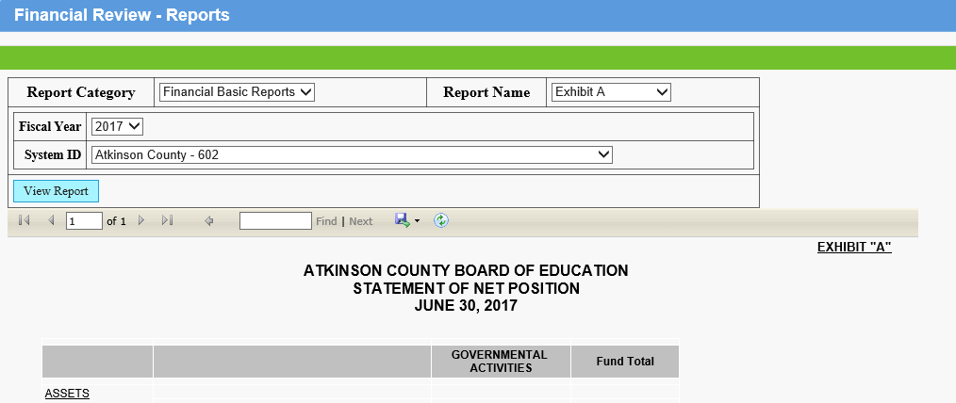
GaDOE Portal
Financial Review Application
  Financial Basic Reports
    All Exhibits and Schedules Mapped by GaDOE

Slide 62
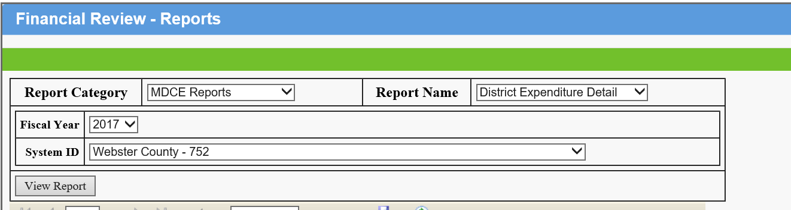
GaDOE Portal
Financial Review Application
  MDCE Reports

Slide 63
GaDOE Portal
Finance Application
  Link is Broken for FIN003 – Financial Analysis Report
  Continue using for Errors and Warning Reports
  Will break links to Basic Financial Reports and MDCE Reports when the FY 2018 year end upload process begins

Slide 64
Federal Administrative Consolidation Pilot

Slide 65
Federal Administrative Consolidation
The Elementary and Secondary Education Act (ESEA), as amended by the Every Student Succeeds Act of 2015 (ESSA), allows a local educational agency (LEA) flexibility to consolidate funds for administration of one or more ESSA programs, upon approval of the Georgia Department of Education (GaDOE). The authority for the consolidation of funds for local administration is found in ESSA Sec. 8201 and Sec. 8203.

Slide 66
Federal Administrative Consolidation
Fund 400
Function 2230
Program Code 8882 – Federal Administrative Consolidation
Follow same process as Federal Schoolwide Consolidation

Slide 67
Federal Administrative Consolidation
Con App Budget – 1 LINE IN EACH PARTICIPATING FEDERAL GRANT!!!!
2230-882
Federal Administration will utilize separate program code – 8882 – to distinguish activity
If consolidating Federal funds for schoolwide, activity is disaggregated by function and program code

Slide 68
Federal Administrative Consolidation
Con App Budget – Fund 400
Only includes one functional category
Ability to consolidate federal funds for administrative tasks
Notes:
We have 4 districts currently participating………Gwinnett, Fulton, Dougherty, and Odyssey Charter. If you are curious as to how this is going…..please ask!

Slide 69

GASB 68

Slide 70
Resources Available on Financial Review’s webpage
For Fiscal Year 2018
  TRS and ERS Allocations for GASB 68 Pension Entries
  TRS and PSERS On Behalf Allocations by Function
  FY 18 GASB 68 Allocation Worksheets
  Instructions for Posting the Net Pension Liability – 2018 Update
  TRS Sample Retirement Packet for DOE
Packets in TRS Employer File Locker; ERS will email their contact. Check with your HR or Payroll Coordinator.

Slide 71

Regional Workshops

Slide 72
Regional Workshops
Monday, May 21 – Bartow County BOE
Wednesday, May 23 – GaDOE – Twin Tower East, 15th Floor, Suite 1566
Tuesday, May 29 – Candler County BOE
Wednesday, May 30 - Coffee County BOE
Friday, June 1– Clarke County BOE
Tuesday, June 5 – Dougherty County BOE
Wednesday, June 6 – Houston County BOE
Notes:
These are FREE workshops, provided for further discussions in a smaller setting. Time is 9-4 each day.

Slide 73
Regional Workshops
Financial Review and Department of Audits Presenting
NEW for FY 18
  Extra discussion at end of day regarding accounting methodology for schoolwide consolidation of funds for Title I
Complete the Survey to let us know which session you plan on attending and any topics you want to cover
Notes:
These are FREE workshops, provided for further discussions in a smaller setting. Time is 9-3 each day, with an hour for lunch. We do these workshops in conjunction wht the Department of Audits. This year we will be focusing heavily on the GASB 68 presentation. We highly recommend that you attend.

Slide 74
Regional Workshops
Agenda
  GASB 75
  FY 19 Budget
  Legislative Updates
  ESSA/Star Rating
  Transparency Dashboard
  Chart of Accounts
  Transferability
  Schoolwide Federal Funds Consolidation
  Department of Audits Topics
Notes:
These are FREE workshops, provided for further discussions in a smaller setting. Time is 9-3 each day, with an hour for lunch. We do these workshops in conjunction wht the Department of Audits. This year we will be focusing heavily on the GASB 68 presentation. We highly recommend that you attend.

Slide 75
Contact Information
Atlanta
  Viola Darrington (404-651-8176) – vdarrington@doe.k12.ga.us
  Steve Lyle (404-656-6769) – slyle@doe.k12.ga.us
  Debara Montgomery (404-656-2344) – dmontgomery@doe.k12.ga.us
  Russ Swindle (404-463-0513) – rswindle@doe.k12.ga.us
Naylor (229-241-9915)
  Rhonda Metts – rmetts@doe.k12.ga.us

Slide 76
Contact Information
Amy Rowell
arowell@doe.k12.ga.us
Georgia Department of Education
1652 Twin Towers East
205 Jesse Hill Jr Drive
Atlanta, GA 30334
404-656-6754

