Slide 1

Georgia’s
Department of Administrative Services
State Purchasing Division
PRESENTATION ON STATEWIDE CONTRACTS
GAINS CONFERENCE
05/03/2018

Slide 2
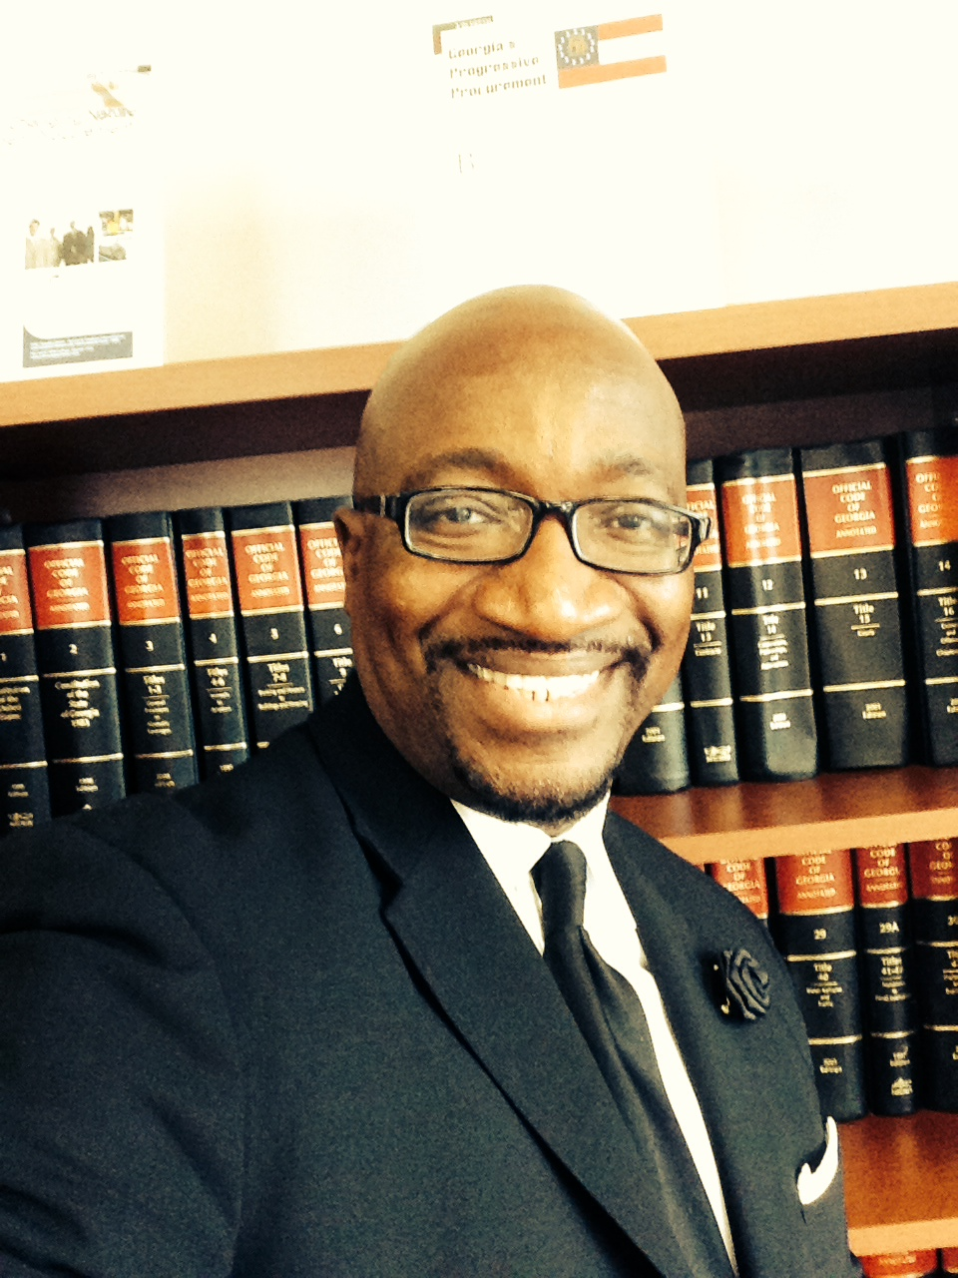
Presenter
Dr. Carl A. Hall, Esq.
Contract Management Manager
State of Georgia

Slide 3
Sourcing Organization
Deputy Commissioner
SPD
Lisa Eason
Administrative Assistant
Lorna Sippo
Deputy State Purchasing Officer
Jan Pytelewski
Director of Audits
Gerald Schaefer
Operations Manager
Josh Borden
Director of Policy and Training
Mary Scruggs
GCM Goods
Rick Beal
GCM Services & IT
Clarence Ingram
Agency Sourcing Manager
Dana Harris
Contract Management and Marketing
Carl Hall
Contract Pricing and Analysis
Darryl Mitchell
Contract Specialist
Bennetta Daniels
Contract Specialist
Czarina Woods
Contract Specialist
Marjorie Sims
Contract Specialist
Eunicia Pop
Sourcing Manager
Kim Ford
Sourcing Manager
Gary Craft
Sourcing Manager
Carrie Steele
Sourcing Manager
Ira Collymore
CM
Alicia Pope
ACM
Vacant
CM
Ezeomo Akhirome
CM
Bernie Joy
Data Analyst
Jalisa Ferguson
Data Analyst
Yolanda Reeder
Data Analyst
Brandon McKeen
CM
Tetchjan Simpson
CM
Carol Kennedy-Sims
CM
Mario Morales
CM
Billy Gilbert
CM
Matt Taylor
CM
Beverly Denson
2 - Contract Specialists Vacant
Notes:
Lisa

Slide 4
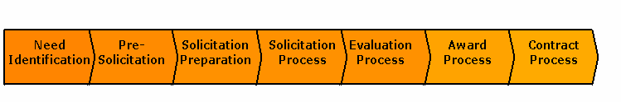
State’s Procurement/RFP Process
7 Stages
NI
Identify need
Form team
EP
Conduct administrative review
Evaluate “technical” proposal
Analyze cost proposal
Conduct negotiations
Finalize contract
PS
Develop requirements
Understand marketplace
Identify procurement strategy
SP
Generate questions from requirements
Generate evaluation/scoring criteria
Determine cost proposal format
Create RFP documents
SPR
Post RFP
Conduct Q & A with Offerors
Receive bids

Slide 5
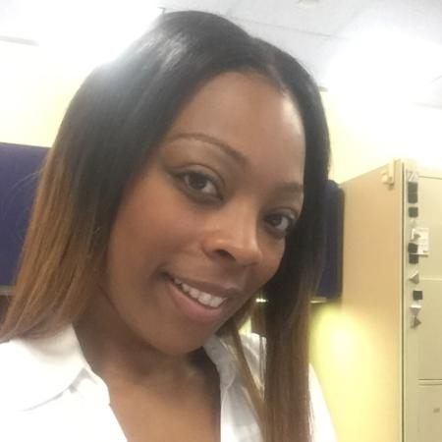
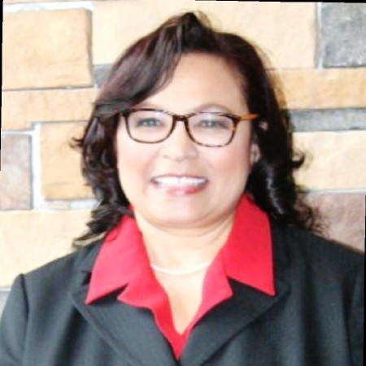


Contract Management Team
Dr. Carl A. Hall, Esq.
Manager
Carl.hall@doas.ga.gov
404-657-4254
Ms. Czarina Woods
CM Specialist
Czarina.woods@doas.ga.gov
404-656-5451
Mrs. Bennetta Daniels
CM Specialist
Bennetta.daniels@doas.ga.gov
404-656-1786
Mrs. Eunicia Pop
CM Specialist
Ms. Marjorie Sims
CM Specialist
Marjorie.sims@doas.ga.gov
404-656-5452

Slide 6
SCOPE OF CONTRACT MANAGEMENT
CONTRACT
RENEWALS/EXTENSIONS
MARKETING
CONTRACT WAIVER
SUPPLIER RELATIONSHIPS

Slide 7
STATEWIDE CONTRACTS
CONTRACT TYPE | APPROX. # OF STATEWIDE CONTRACT SUPPLIERS | APPROX. # OF STATEWIDE CONTRACTS
GOODS | 212 | 31
TECHNOLOGY | 77 | 17
SERVICES | 56 | 25
TOTALS | 345 | 73

Slide 8
State of Georgia Legal Requirements
State Purchasing Act
Assistance to Local Government
“Local political subdivisions, including counties, municipalities, and school boards are authorized by state law to purchase their supplies, materials, and equipment through SPD (State Purchasing Division) if they so desire. Purchases pursuant to this authorization may take the form of one-time open market purchases or statewide contracts specifically open to use by local political subdivisions. All products and/or services offered by suppliers pursuant to statewide contracts may be offered to local political subdivisions as well as state entities in accordance with the terms of such statewide contracts.”

Slide 9
Becoming Familiar with a Statewide Contract (SWC) RFP Documents
General “eRFP” Solicitation Document
  General Description of RFP
  Timeline of events
  Instructions for suppliers on using Team Georgia Marketplace
  Information on Insurance, SWC, contract term, etc.
  Bid Factors, Scoring, Selection
Technical Questions Worksheet
  Mandatory (Must Have) – Yes/No or Pass/Fail Questions
  Mandatory Scored (Must Have) – Assigned a Point Value
  Additional Scored (Nice to Have/Extras) – Assigned a Point Value

Slide 10
Becoming Familiar with a Statewide Contract (SWC) RFP Documents
Pricing Worksheet (Evaluated Separately)
  Discount by type such as hardware, software, maintenance, training, etc.
Miscellaneous Documentation Requirements
  Supplier Information Worksheet
  Tax Form
  E-Verify Form
  SWC Contract Template
  Q&A Template

Slide 11
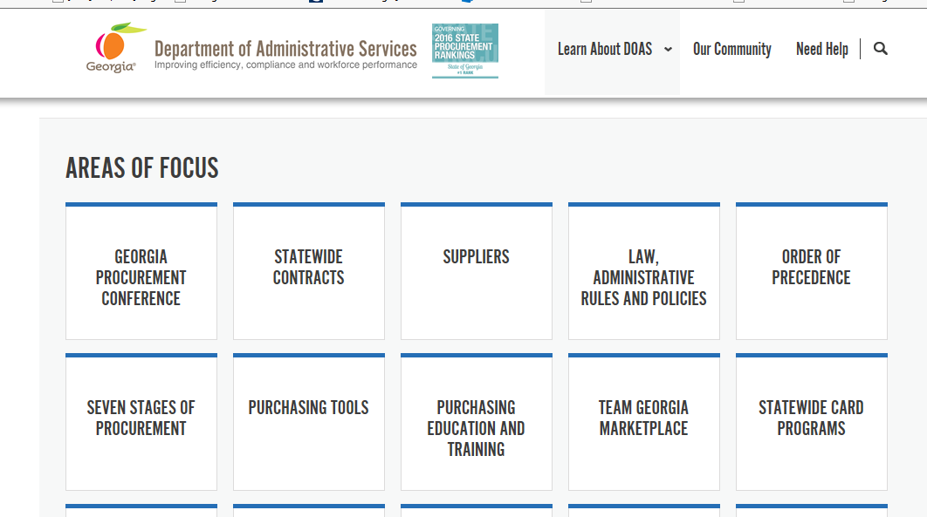
ACCESS STATEWIDE CONTRACTS
Visit the DOAS website at www.doas.ga.gov.
STATE PURCHASING Division

Slide 12
General Public
Click Statewide Contract Index and log in using the following guest ID and password to navigate to the "Contracts" tab to search or browse available contracts.
ID: tgmguest
password: tgmguest

Slide 13
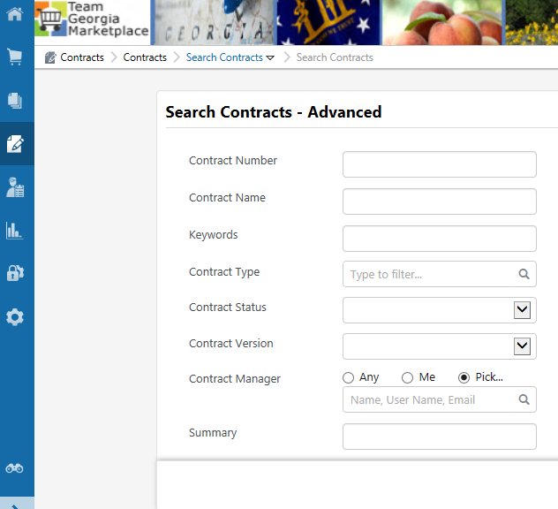
SEARCH STATEWIDE CONTRACTS

Slide 14
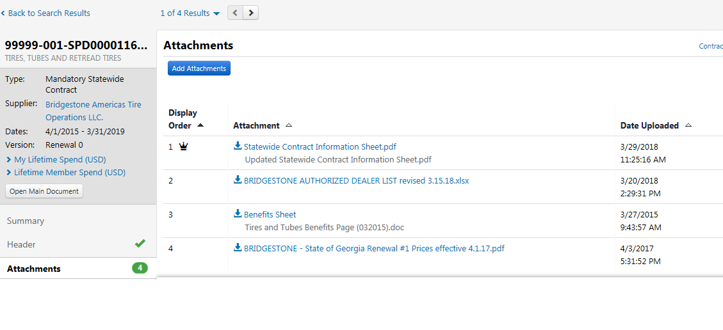
IMPORTANT ATTACHMENTS

Slide 15
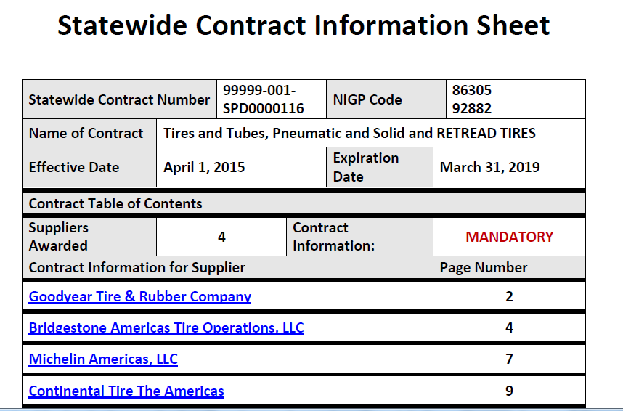

Slide 16
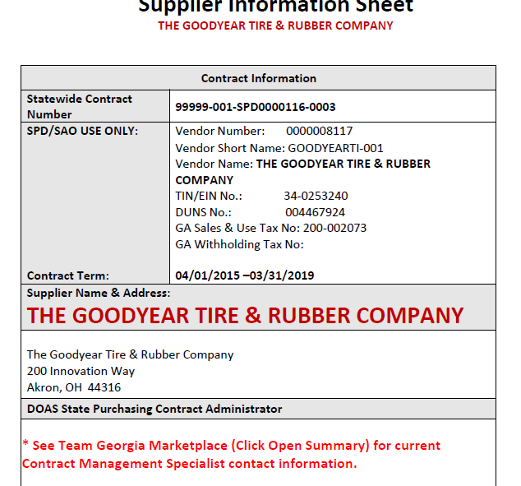

Slide 17
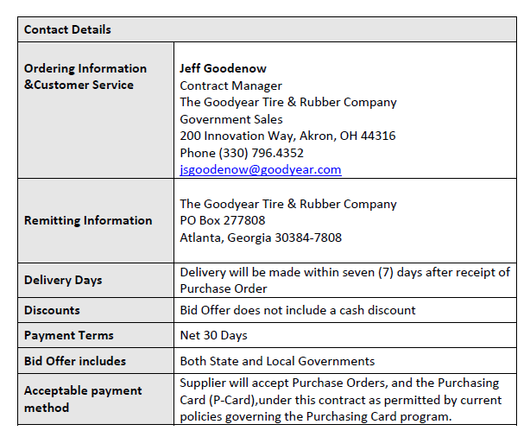

Slide 18
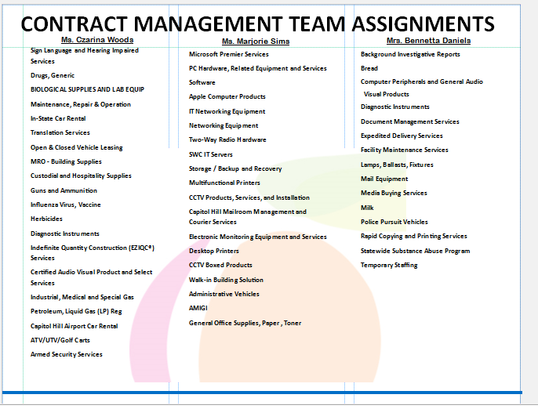
WHAT DO I DO IF I HAVE A QUESTION REGARDING A STATEWIDE CONTRACT

Slide 19
Contract Management Team
Dr. Carl A. Hall, Esq.
Manager
Carl.hall@doas.ga.gov
404-657-4254
Ms. Czarina Woods
CM Specialist
Czarina.woods@doas.ga.gov
404-656-5451
Mrs. Bennetta Daniels
CM Specialist
Bennetta.daniels@doas.ga.gov
404-656-1786
Ms. Marjorie Sims
CM Specialist
Marjorie.sims@doas.ga.gov
404-656-5452
Mrs. Eunicia Pop
CM Specialist

Slide 20


Slide 21


