Slide 1
G.A.I.N.S Georgia Accounting Information Network Support
Legislative and Legal Update
May 6, 2010
Presented by: Cory O. Kirby
Harben, Hartley & Hawkins, LLP
Gainesville, Georgia

Slide 2
What is Brewing in the Legislature?

Slide 3
HB 61 SALES AND USE TAX
Both Purchaser and dealer who acquire or sells tangible personal property outside this state, where the
property is to be used, consumed, distributed, stored, or delivered electronically or physically in Georgia
is required to pay 4% tax
Failure to provide required Tax Notice or file Sales and Use Tax Statement =
penalties of:
$5/for each failure to provide Notice
$10/for each failure to file Statement

Slide 4
HB 65 Medical Marijuana
Creates a commission on Low THC Medical Oil Access
Expands use of Medical Cannabis Oil for:
PTSD if 18 or older
Intractable pain – pain that “generally
accepted medical practice” is unable to
provide relief within 6 minutes

Slide 5
HB 159 Supporting and Strengthening Families Act
“A parent of a child may delegate caregiving authority regarding such child to an individual
who is an adult, who resides in this state, and who is the grandparent, great-grandparent,
stepparent, former stepparent, step-grandparent, aunt, uncle, great aunt, great uncle, cousin,
or sibling of such child or is a nonrelative who is approved as an agent by a child-placing
Agency or a nonprofit entity or faith based organization for a period not to exceed one year,
except as provided in Code Section 19-9-132, by executing a power of attorney that
substantially complies with this article.”
Person executing the Power of Attorney must require the prospective caregiver to
submit to criminal background check, unless caregiver is the grandparent, great-
Grandparent, stepparent, former stepparent, step-grandparent, aunt, uncle, great
Aunt, great uncle, cousin, or sibling of such child.
Power of attorney not to exceed one year, unless grandparent
REPLACES GRANDPARENT ACT

Slide 6
HB 159 (cont’d) Supporting and Strengthening Families Act
Don’t Confuse With Caregiver Educational Consent Act

Slide 7
SB 186: O.C.G.A. § 20-1-15 Caregiver Educational Consent Act
(3) Kinship caregiver- grandparent (or great), aunt, uncle, (or great), cousin, sibling, or fictive kin who has assumed responsibility for raising child in informal, noncustodial, or guardianship capacity for specific reasons
(2) Fictive kin- individual known to child as relative, but not related by blood or marriage and with whom child has resided or had significant contact

Slide 8
Caregiver Educational Consent Act
Authorizes kinship caregiver to give legal consent by executing affidavit for child not in DFCS custody to
receive educational services
receive medical services directly related to academic enrollment, or
participate in extracurricular activities
Affidavit in O.C.G.A. § 20-1-18; valid for one year
Does not supersede grandparent power of attorney in O.C.G.A. § 19-9-129

Slide 9
HB 159 (cont’d) Supporting and Strengthening Families Act
If Board of Education provides paternity/maternity leave for
Biological parents for birth, parents adopting child, upon request, shall receive same leave

Slide 10
HB 217 Qualified Education Tax Credit
Increased total aggregate tax credit amounts from $58,000,000 to $100,000,000
from January 1, 2019 – December 31, 2028
And then back to $58,000,000 for January 1, 2029

Slide 11
Georgia Qualified Education Expense Tax Credits – O.C.G.A. § 48-7-29.13
Tax credit is significantly more beneficial than tax deduction: credit reduces tax liability dollar for dollar, while deduction reduces taxable income upon which taxes are calculated
$1000 per individual, $2500 per married couple
GOAL donors can designate private school(s) to benefit from donation, but not individual student(s)

Slide 12
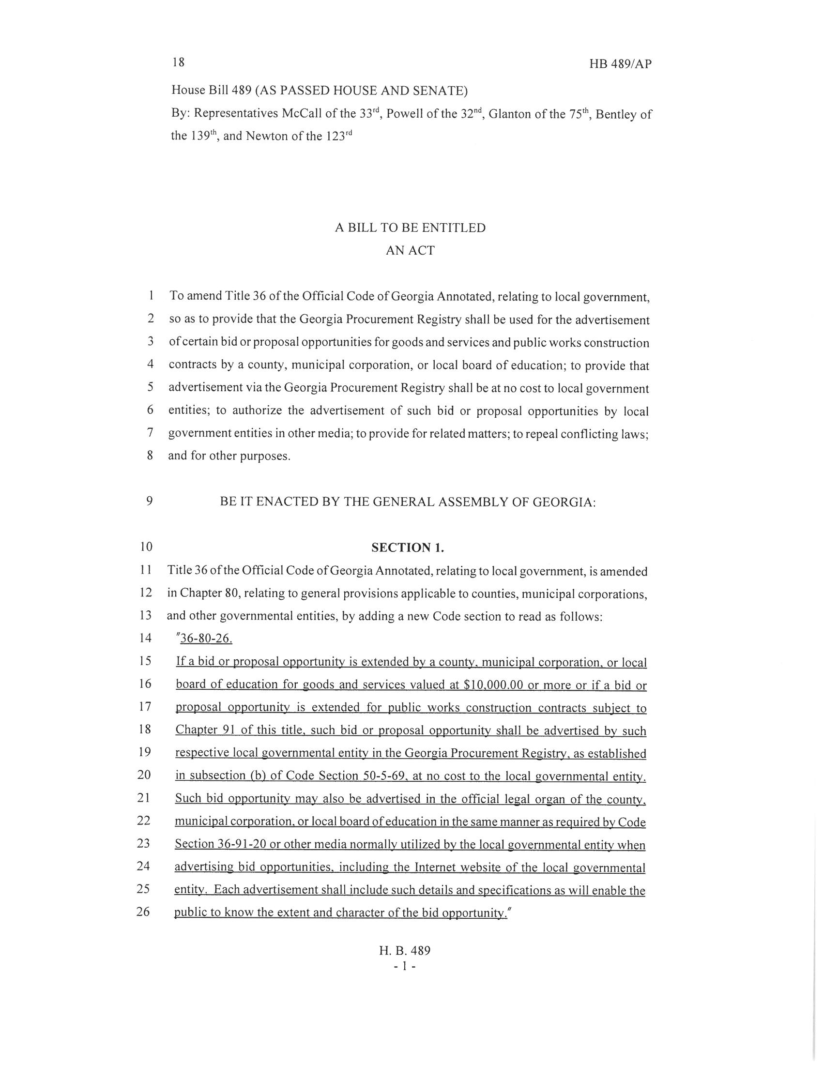
HB 489 Competitive Bid/Proposal
Competitive process for goods or services in excess of $10,000
Shall be advertised in the Georgia Procurement Registry
May be advertised in legal organ or on website

Slide 13
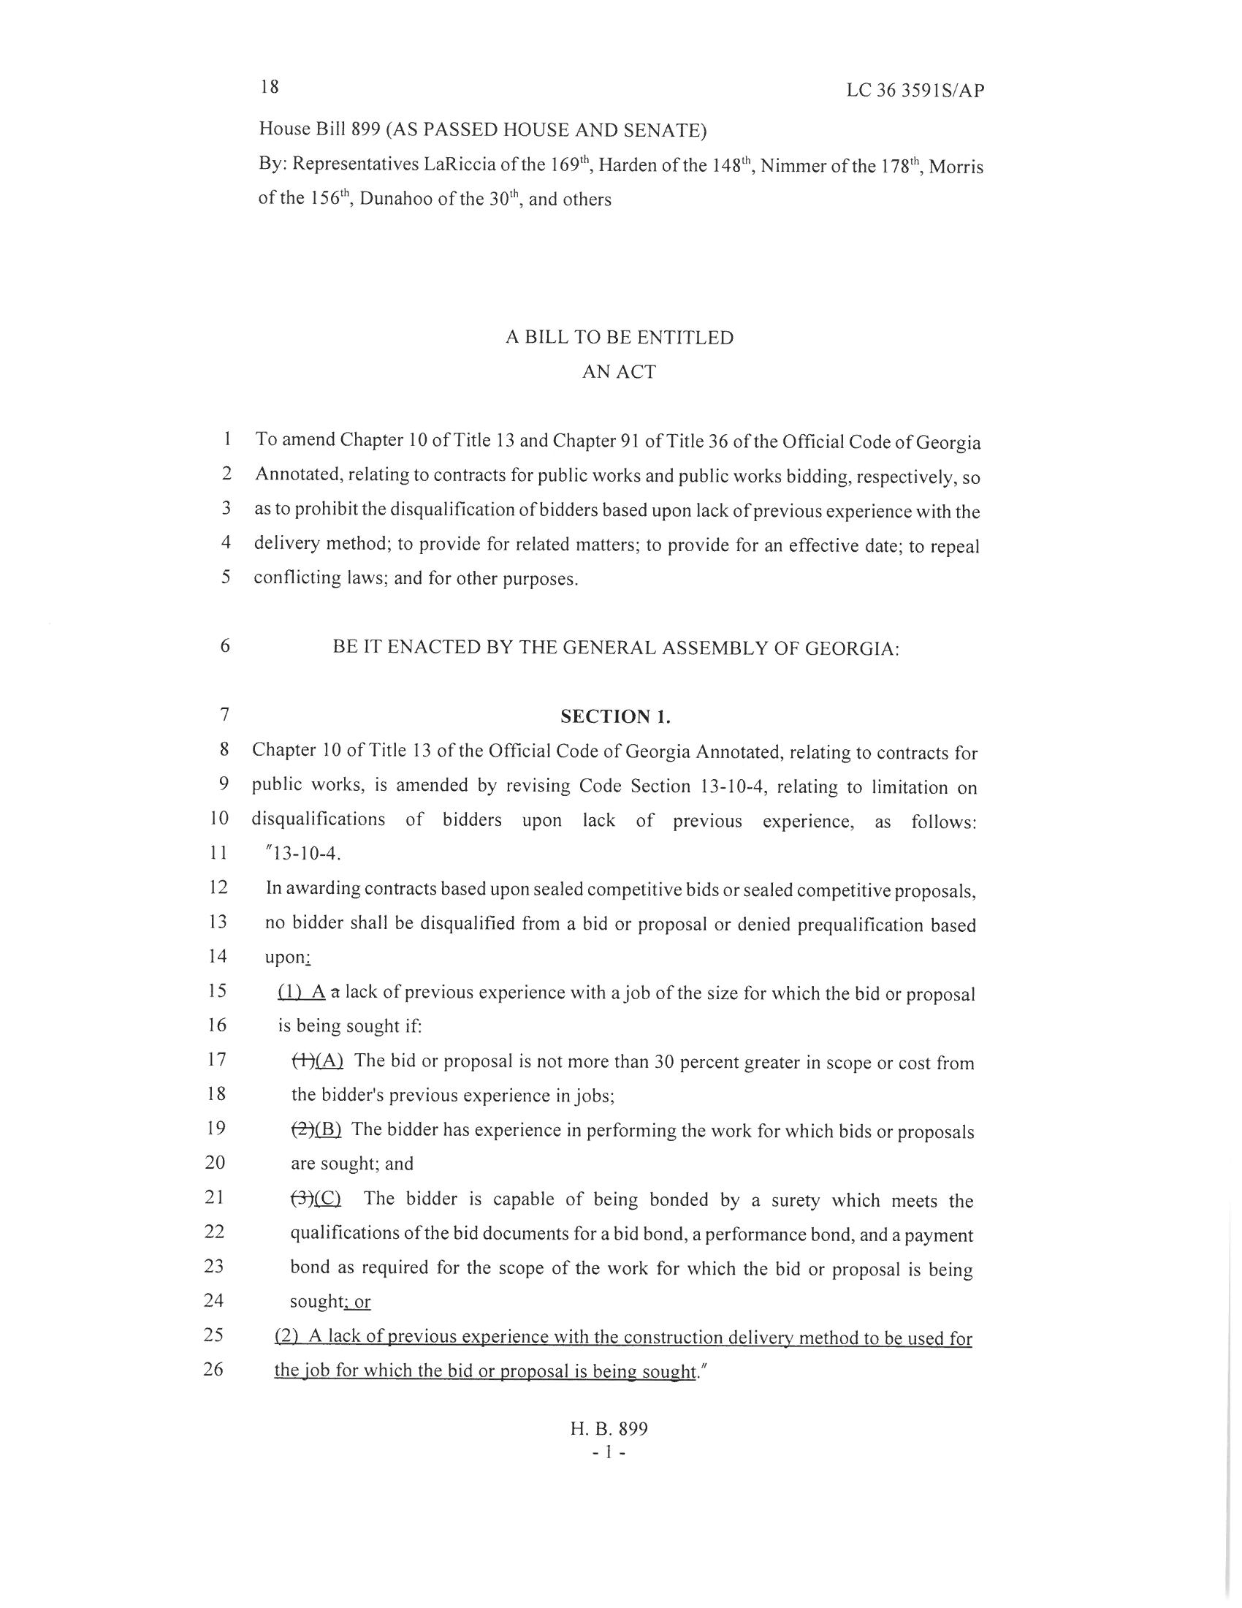
HB 899 Competitive Bid/Proposal
“In awarding contracts based upon sealed competitive bids or sealed competitive proposals,
no bidder shall be disqualified from a bid or proposal or denied prequalification based
upon;
Lack of experience with job size if
Bid/proposal not more than 30% grater than previous experience
Has experience in performing work; and
Can get bid, payment and performance bonds
Lack of experience with construction delivery method

Slide 14
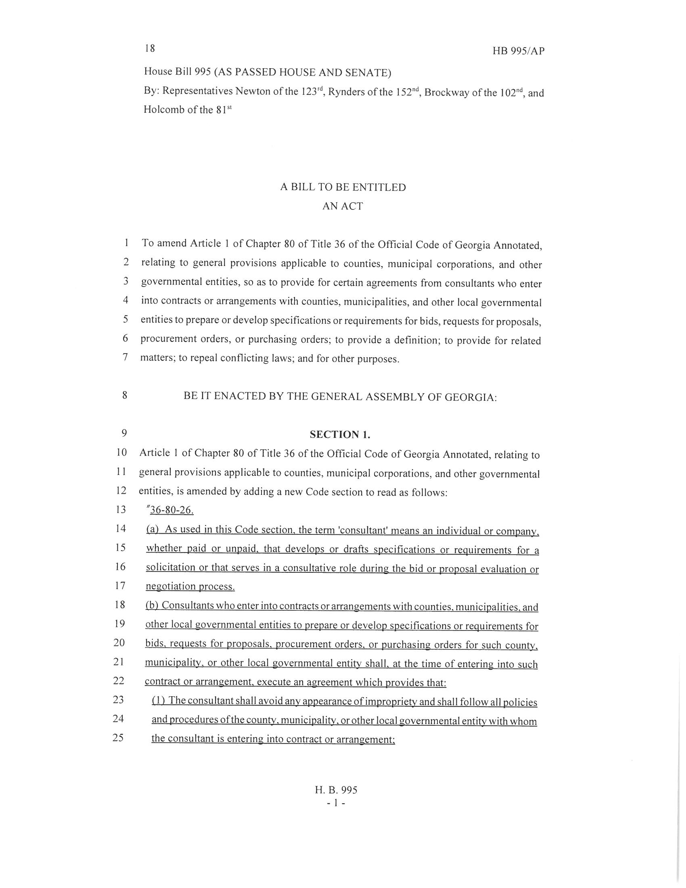
HB 995 Competitive Bid/Proposal - Consultant
As used in this Code section, the term ‘consultant’ means an individual or company.
whether paid or unpaid, that develops or drafts specifications or requirements for a
solicitation or that serves in a consultative role during the bid or proposal evaluation or
negotiation process.
(b) Consultants who enter into contracts or arrangements with counties, municipalities, and
other local governmental entities to prepare or develop specifications or requirements for
bids, requests for proposals, procurement orders, or purchasing orders for such county,
municipality, or other local governmental entity shall, at the time of entering into such
contract or arrangement, execute an agreement which provides that:

Slide 15
HB 995 cont’d
Avoid appearance of impropriety
Immediately disclose any possible conflict of interests
Best efforts to avoid conflict of interest
if such is discovered and can’t be negotiated,
money returned to district
Cannot submit bid/proposal in response to solicitation
that consultant drafted
During evaluation process/negotiation, must maintain
confidentiality

Slide 16
HB 740 Student Discipline
“(b) No student in public preschool through third grade shall be expelled or suspended from
school for more than five consecutive or cumulative days during a school year without first
receiving a multi-tired system of supports, such as response to intervention, unless such
student possessed a weapon, illegal drugs, or other dangerous instrument or such student’s
behavior endangers the physical safety of other students or school personnel.”

Slide 17
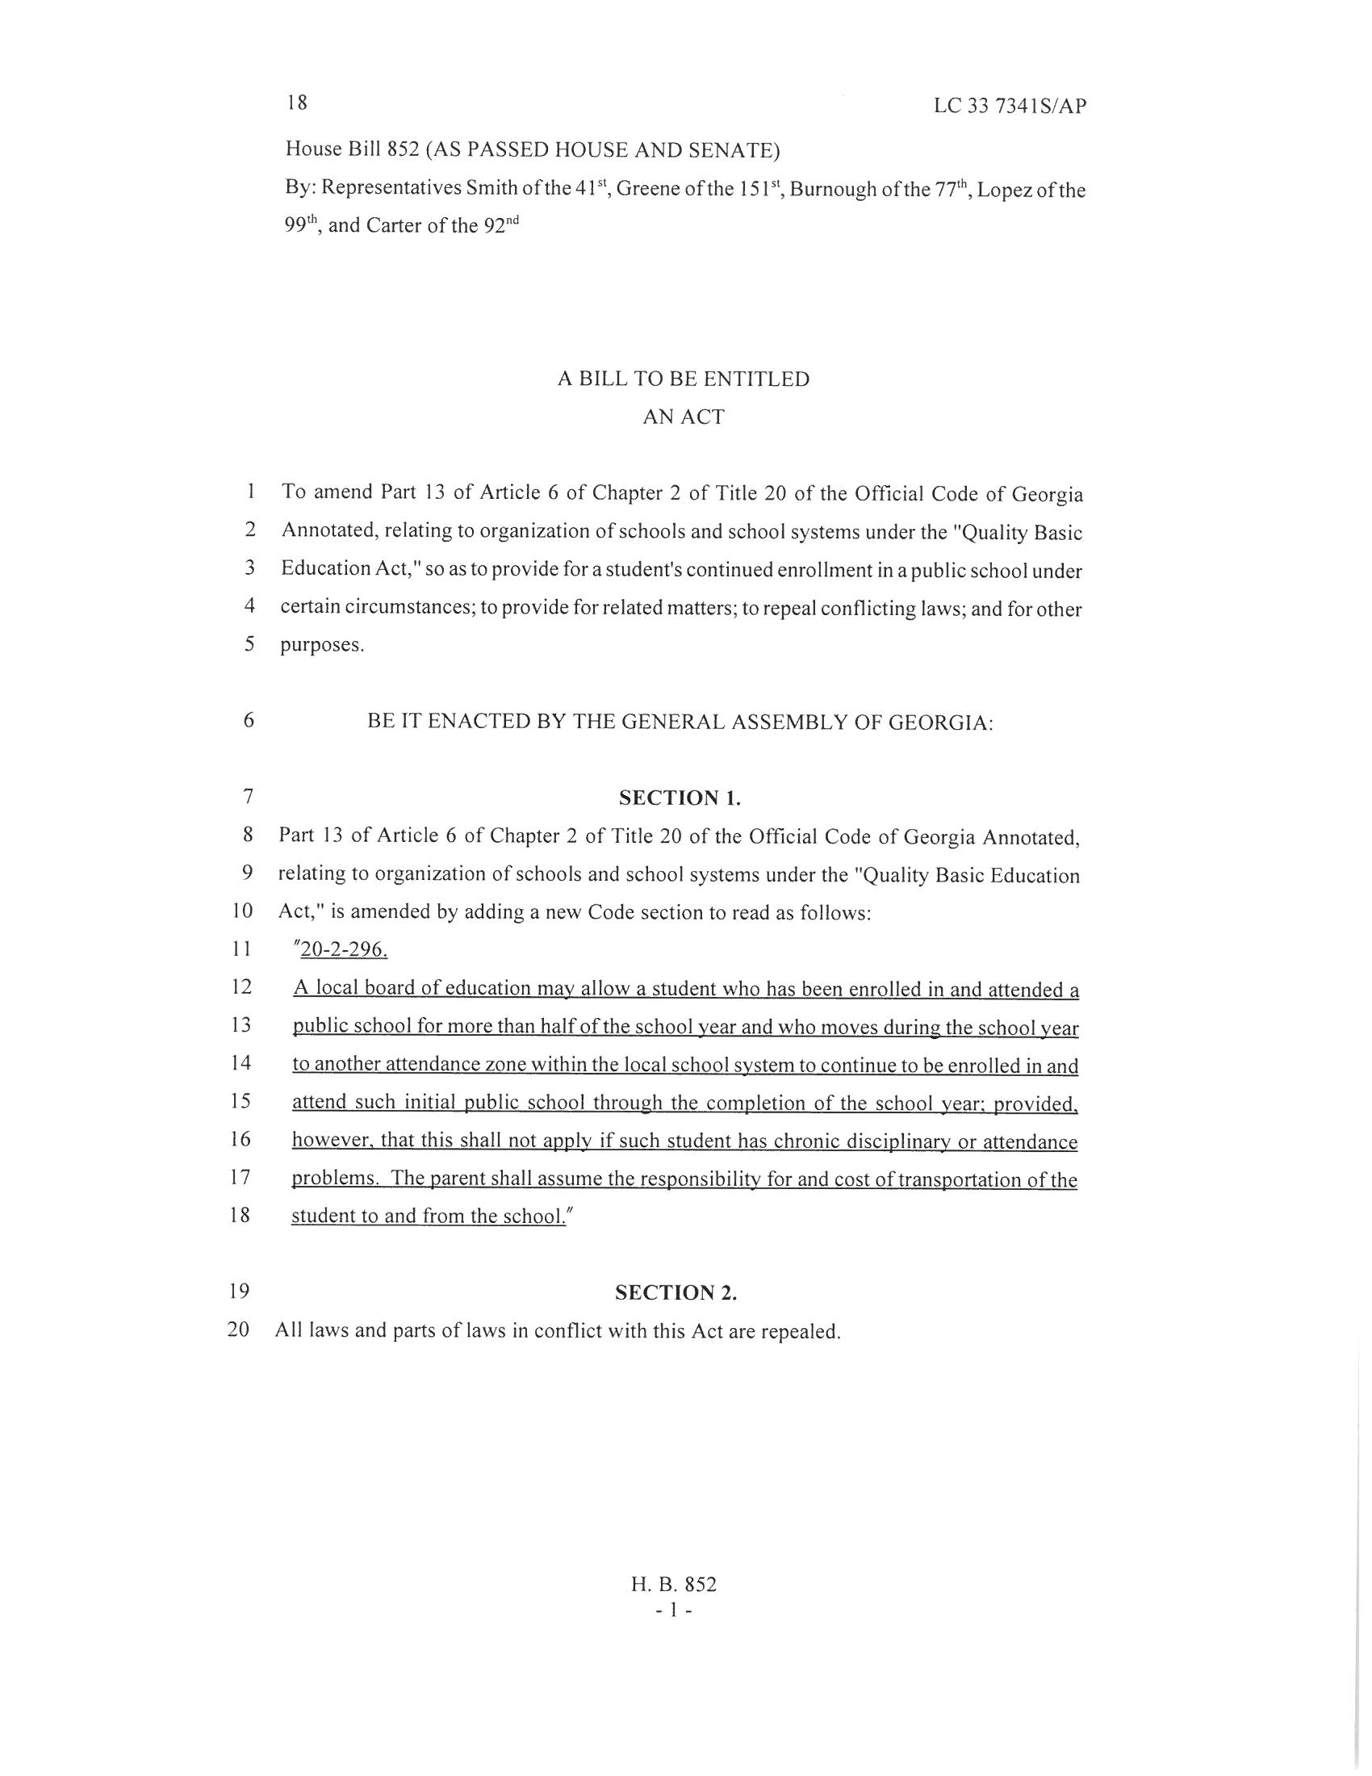
HB 852 Enrollment
“A local board of education may allow a student who has been enrolled in and attended a
public school for more than half of the school year and who moves during the school year
to another attendance zone within the local school system to continue to be enrolled in and
attend such initial public school through the completion of the school year; provided,
however, that this shall not apply if such student has chronic disciplinary or attendance
problems. The parent shall assume the responsibility for and cost of transportation of the
student to and from the school.”

Slide 18
Governor signs new Georgia budget that finally fully funds schools

Slide 19
What Did NOT Pass?

Slide 20
HB 273 Recess Bill
DID NOT PASS
All K-5 students must be scheduled recess each day for 30 minutes unless:
> PE/structured activity time
>Weather
>Assemblies, etc
Elementary School “encouraged” to include an average of 30 minutes of unstructured activity per day

Slide 21
HB 273 Recess Bill
DID NOT PASS
Local boards of education shall establish written policies to ensure that recess is a safe experience for students, that recess is scheduled so that it provides a break during academic learning, and that recess is not withheld for disciplinary or academic reasons.

Slide 22
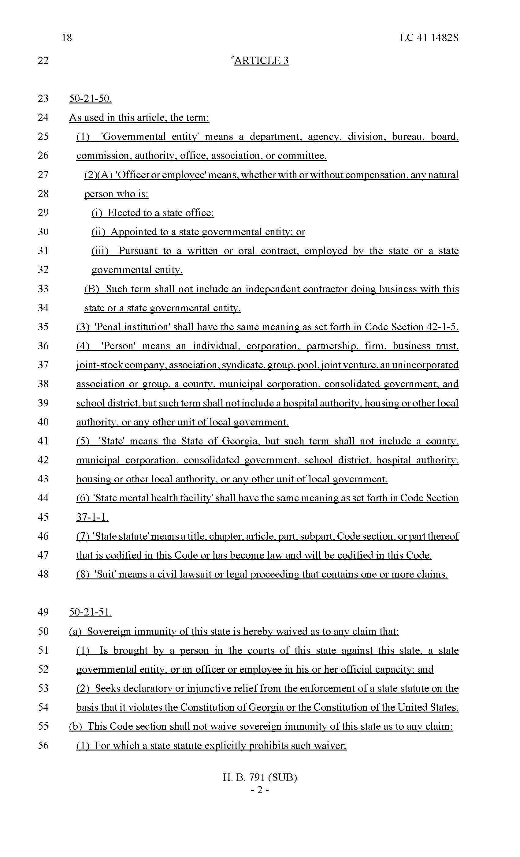
HB 791
Sovereign Immunity Waiver
DID NOT PASS
Sovereign immunity of this state is hereby waived as to any claim that:
Is brought by a person in the courts of this state against this state, a state
Governmental entity, or an officer or employee in his or her official capacity; and
Seeks declaratory or injunctive relief from the enforcement of a state statute on the
Basis that it violates the Constitution of Georgia or the Constitution of the United States,
“State” means the State of Georgia, but such term shall not include a county,
Municipal corporation, consolidated government, school district, hospital authority,
Housing or other local authority, or any other unit of local government.

Slide 23
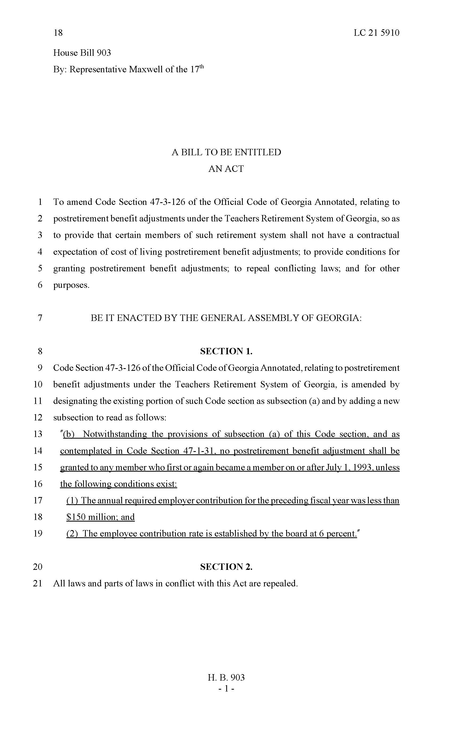
HB 903
Teachers’ Retirement System
DID NOT PASS
"(b) Notwithstanding the provisions of subsection (a) of this Code section, and as
contemplated in Code Section 47-1-31, no postretirement benefit adjustment shall be
granted to any member who first or again became a member on or after July 1, 1993, unless
the following conditions exist:
(1) The annual required employer contribution for the preceding fiscal year was less than
(2) The employee contribution rate is established by the board at 6 percent."

Slide 24
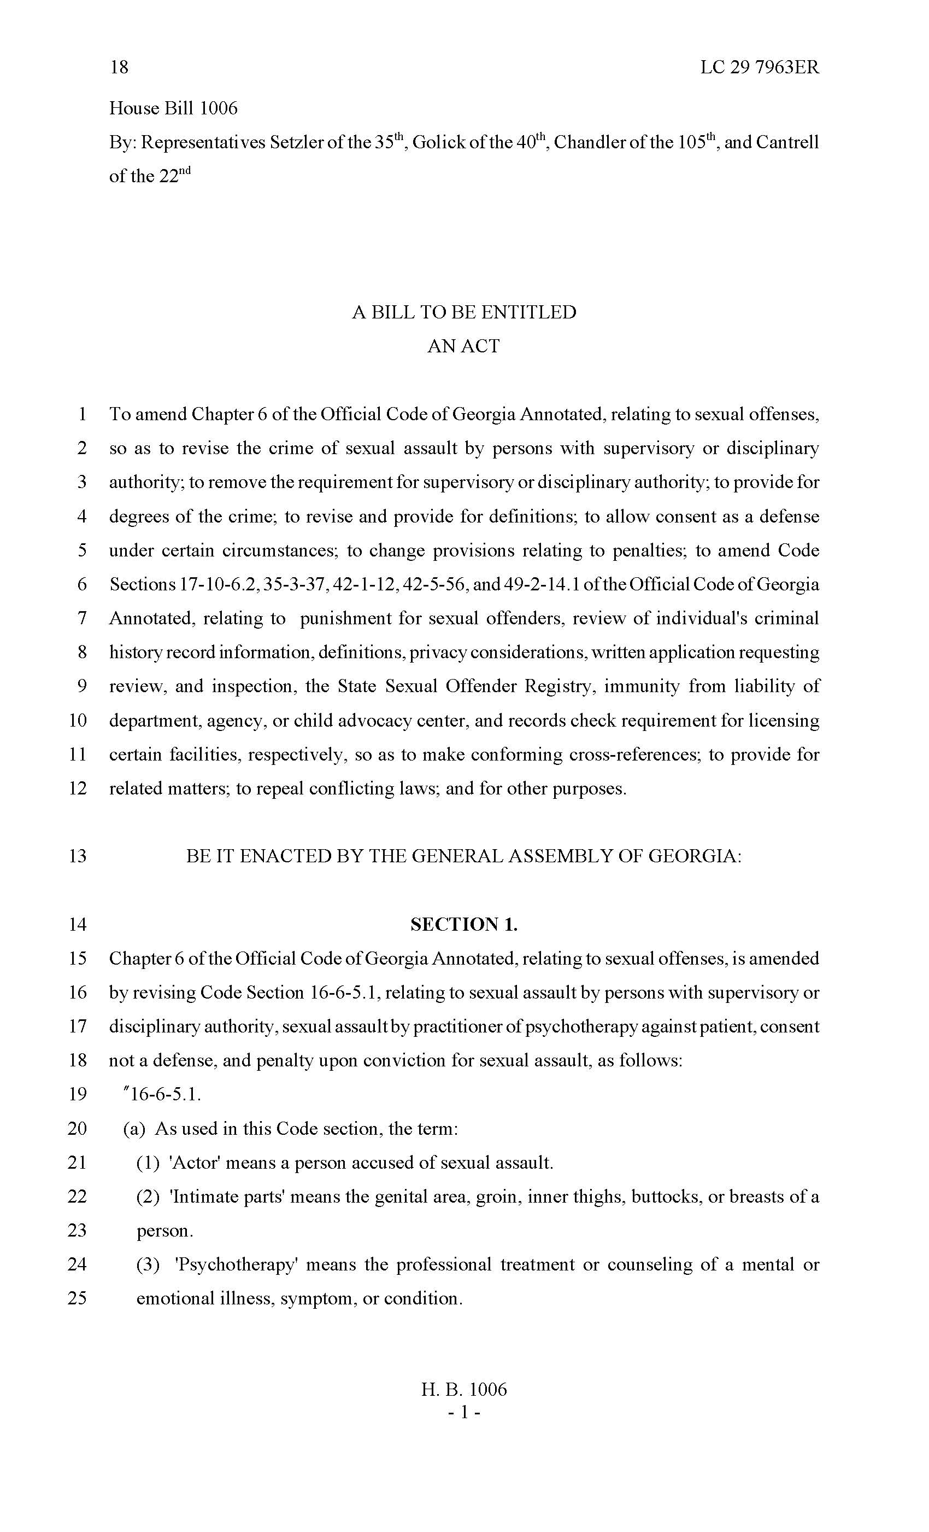
HB 1006
Sexual Assault by Persons with Authority
DID NOT PASS
A person who has supervisory or disciplinary authority over another individual
commits sexual assault in the second degree when that person:
(1) Is a teacher, principal, assistant principal, or other administrator employee or agent
of any a school and engages in sexual contact with such other individual who the actor
knew or should have known is enrolled at the same school
A person commits sexual assault in the first degree when that person:
(1) Is a teacher, principal, assistant principal, or other employee or agent of a school and
engages in sexually explicit conduct with such other individual who the actor knew or
should have known is enrolled at the same school;

Slide 25
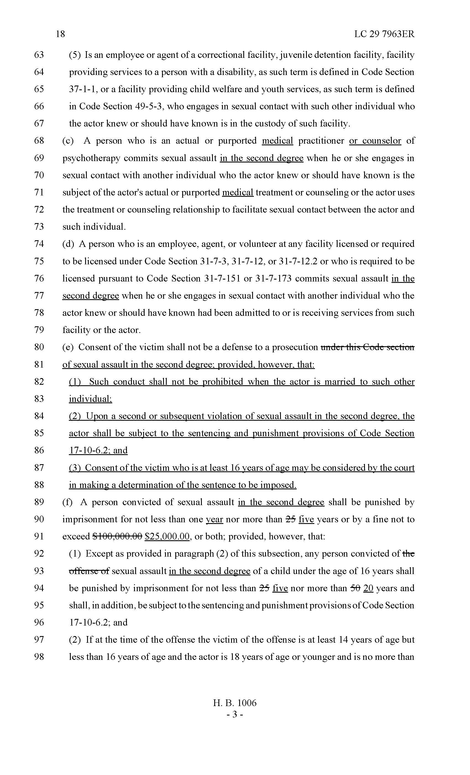
Consent of the victim shall not be a defense to a prosecution under this Code section
of sexual assault in the second degree; provided, however, that:
Such conduct shall not be prohibited when the actor is married to such other
individual;
DID NOT PASS

Slide 26
And NOW It’s Time For Cory vs. Amy

Slide 27
Our First Category of the Days is…

Slide 28
Budget Process
O.C.G.A. §20-2-167 (a)(5)
The budget of each local school system shall reflect all anticipated revenues from each source. The budget of each local school system shall designate all of such anticipated revenues among the several funds or accounts of the system and shall not leave any anticipated revenues undesignated. Except as other wise provided in this paragraph, all amounts allocated to each expenditure within the budget year for the purposes of that fund or account.

Slide 29
Budget Process cont’d.
O.C.G.A. §20-2-167 (c)
The State Board of Education is authorized to prescribe a date by which each local unit of administration must submit a budget to the state board. The regulations developed by the state board must make adequate provision for local revenue and modification prior to local approval and submittal to the State School Superintendent.

Slide 30
Budget Process cont’d.
O.C.G.A. §20-2-167 (e)
No later than October 1, 2005, the State Board of Education shall develop rules and regulations requiring that each local board of education provide information as specified by the state board and which is not specifically made confidential by law, including school site budget and expenditure information and site average class size by grade, to members of the school council and the general public.

Slide 31
Budget Process cont’d.
O.C.G.A. §20-2-167.1 (c)
A summary of the annual operating budget proposed by the governing board and the annual operating budget adopted by the governing board shall be posted on a publicly available area of such governing body’s website. The summary of the annual operating budget adopted by the governing body shall be maintained on such publicly available area of the website until the annual operating budget for the next fiscal year is adopted by the governing body.

Slide 32
Still questions and confusion regarding O.C.G.A. §20-2-167.1 and “Public Meetings”…

Slide 33
Did you see this?

Slide 34
From: Amy Rowell Sent: Friday, April 13, 2018 2:45 PM To: K12 Financial Review Coordinators <k12financialreview@list.doe.k12.ga.us>; K12 Charter School Administrators <k12charterschooladmin@list.doe.k12.ga.us> Cc: Ted Beck <tbeck@doe.k12.ga.us> Subject: FMGLUA Chapter IV-2 - Preparing Operating Budgets
Dear K12 Finance Officers:
House Bill 65 during the 2015-2016 legislative session provided additional requirements surrounding the budget process for LEAs. O.C.G.A. Section 20-2-167.1 requires each LEA to hold at least two public meetings prior to the adoption of the initial budget. The public meetings are required to be advertised in a local newspaper of general circulation, and should be the same newspaper utilized for all legal announcements of the board of education. Additionally, the law further requires the LEA’s to post both the proposed and adopted annual budgets on a publicly available area of the LEA’s website.
The law does not explicitly require the tentative budget to be advertised in the legal news organ.
State Board Rule 160-5-2-.21 requires each LUA to comply with the procedures prescribed in the Financial Management for Georgia Local Units of Administration (FMGLUA) for the preparation of the annual budget reports. Chapter IV-2 – Preparing Operating Budgets of the FMGLUA previously required LEAs to advertise the tentative budget at least two weeks prior to the final adoption of the initial budget. This requirement is a policy requirement, and not a requirement set forth in the law.
In order to be consistent with the requirements in the law, the FMGLUA has been revised to eliminate the requirement to advertise the tentative budget. The tentative budget must be published on the LEA’s external website, and the reporting/advertising requirements surrounding the millage rate as set forth in O.C.G.A. 48-5-32.1 still apply.
Additionally, the advertisements for the public meetings should reference the website location of the budget documents published for review. Each LEA should determine the most optimal method of communication to the constituents. If the LEA’s constituents are more likely to review the budget documents in the legal news organ, then the LEA may make the local decision to continue advertising the tentative budget in that manner. However, since the advertisement of the tentative budget is not required by Title 20 Code, the FMGLUA has been updated.
Please note that the requirements surrounding the public meetings and publication of the proposed and adopted budgets are in the spirit of promoting the most transparent operations as possible. Each local board of education should develop the budget policies that best meet the initiatives of public involvement in the budgetary process for their LEA.
Please contact Financial Review if you have any questions regarding the revised FMGLUA Chapter IV-2.
Thank you,

Slide 35
FMGLUA revisions
Informal Budget Hearings:
Administrators develop budget
Superintendent presents to Board of Education

Slide 36
FMGLUA revisions
Two Public Hearings:
Held before Board of Education adopts budget
For public input on budget
Not in same week

Slide 37
FMGLUA revisions
Tentative Budget:
Adopt 2 weeks prior to proposed budget
Publish Tentative and Initial Budget:
Publish tentative on website until final
Final stays on website new final

Slide 38
What is the “initial budget”?

Slide 39
Waivers
What did you waive as a Charter School or Strategic Waiver System?
Expenditure Controls?
20-2-171
20-2-167
20-2-411
Various Attorney General Opinions
Georgia Constitution Amended 8, §6, ¶1

Slide 40
Charter School Law O.C.G.A. § 20-2-2065
(a) Except as provided in this article or in a charter, a charter school, or for charter systems, each school within the system, shall not be subject to the provisions of this title or any state or local rule, regulation, policy, or procedure relating to schools within an applicable school system regardless of whether such rule, regulation, policy, or procedure is established by the local board, the state board, or the Department of Education;

Slide 41
Strategic Waiver School System Law O.C.G.A. § 20-2-82
(e) The state board shall be authorized to approve a waiver or variance request of specifically identified state rules, regulations, policies, and procedures or provisions of this chapter upon the inclusion of such request in the local school system's proposed contract and in accordance with subsection (b) of Code Section 20-2-84.

Slide 42
What must be waived in SWS systems under O.C.G.A § 20-2-84?
(b) The flexibility component of the contract…shall include the waiver or variance of at least one of the areas in paragraphs (1) through (4) of this subsection as requested by the local school system:
1) Class size requirements in Code Section 20-2-182;
2) Expenditure controls in Code Section 20-2-171 and categorical allotment requirements in Article 6 of this chapter;
3) Certification requirements in code Section 20-2-200;
4) Salary schedule requirements in Code Section 20-2-212; and
5) Any other requirements or provisions of this chapter as identified by the local school system and approved by the state board except as provided in subsection (e) of Code Section 20-2-82.

Slide 43
What cannot be waived in SWS systems under O.C.G.A § 20-2-82(e)?
The state board shall not be authorized to waive or approve variances on
any federal, state, and local rules, regulations, court orders, and statutes relating to civil rights;
insurance;
protection of the physical health and safety of students, employees, and visitors;
conflicting interest transactions;
prevention of unlawful conduct;
laws relating to unlawful conduct in or near a public school;

Slide 44
What cannot be waived in SWS systems under O.C.G.A § 20-2-82(e)? cont’d
reporting to state-wide information system;
Chapter 14 (accountability);
annual performance evaluations (but what about SB 364?);
fingerprinting and background checks;
individual graduation plans;
requirement not to charge tuition or fees to its students except as may be authorized under O.C.G.A. § 20-2-133, and to remain open to enrollment in the same manner as before the waiver request;
rules about virtual instruction for out-of-district students – last year’s HB 100

Slide 45
What cannot be waived in charters under O.C.G.A § 20-2- 2065?
Everything on the previous two slides, plus
Moment of quiet reflection, and
Annual audit.

Slide 46
OK, but can I pay for…
Charter buses to go to state football playoffs?
Teacher appreciation gifts?
After School Day Care?
Lunch for Employees?
Clothing , food, supplies for students?
Loans for Boosters?
Uniforms?
Bonuses?

Slide 47
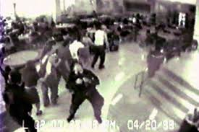
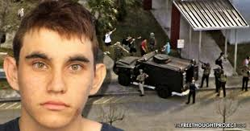
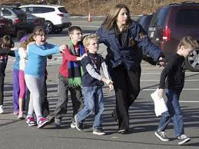

Slide 49
What Is Already in Georgia Law?

Slide 50
Guns/Weapons in the Schools O.C.G.A. § 16-11-127.1
(b)(1) Except as otherwise provided in subsection (c) of this Code section, it shall be unlawful for any person to carry to or to possess or have under such person's control while within a school safety zone or on a bus or other transportation furnished by a school any firearm or explosive compound, other than fireworks.

Slide 51
Picking up a child at school?
A person who is licensed … when such person carries or picks up a student within a school safety zone, a school function, or on a bus or other transportation furnished by a school or
a person who is licensed … when he or she has any weapon legally kept within a vehicle when such vehicle is parked within a school safety zone or is in transit through a designated school safety zone;
O.C.G.A. § 16-11-127.1(c)(7)

Slide 52
Weapons in Motor Vehicle
Provisions of the code section shall not apply to teachers and other personnel who are otherwise authorized to possess or carry weapons, provided that any such weapon is in a locked compartment of a motor vehicle or one which is in a locked container in or a locked firearms rack which is on a motor vehicle;
O.C.G.A. § 16-11-127.1(c)(17)

Slide 53
Guns/Weapons in the Schools O.C.G.A. § 16-11-130.1
As used in this Code section, the term:
(1) ‘Bus or other transportation furnished by a school’ means a bus or other transportation furnished by a public or private elementary of secondary school.
(2) ‘School function’ means a school function or related activity that occurs outside of a school safety zone for a public or private elementary or secondary school.
(3) ‘School safety zone’ means in or on any real property or building owned by or leased to any public or private elementary or secondary school or local board of education and used for elementary or secondary education.
(4) ‘Weapon’ shall have the same meaning as set forth in Code Section 16-11-127.1.

Slide 54
O.C.G.A. § 16-11-130.1 cont’d
(b) This Code section shall not be construed to require or otherwise mandate that any LBOE or school administrator adopt or implement a practice or program for the approval of personnel to possess or carry weapons within a school safety zone, at a school function, or on a bus or other transportation furnished by a school nor shall this Code section create any liability for adopting or declining to adopt such practice or program. Such decision shall rest with each individual LBOE. If a LBOE adopts a policy to allow certain personnel to possess or carry weapons … such policy shall include approval of personnel to possess or carry weapons and provide for:

Slide 55
O.C.G.A. § 16-11-130.1 cont’d
(b)(1) Training of approved personnel prior to authorizing such personnel to carry weapons….
(2) An approved list of the types of weapons and ammunition and the quantity …
The exclusion from approval of personnel who has had an employment or other history indicating any type of mental or emotional instability…
A mandatory method of securing weapons which shall include at a minimum the requirement that the weapon, if permitted to be carried concealed by personnel, shall be carried on the person and not in a purse, briefcase, bag or similar other accessory … if maintained separate from person, shall be maintained in a secured lock safe or similar local box that cannot be easily accessed by students.

Slide 56
O.C.G.A. § 16-11-130.1 cont’d
(c) Any personnel selected to possess or carry weapons … shall be a license holder, and the LBOE shall be responsible for conducting a criminal history background check … annually to determine whether such personnel remains qualified ….
(d) The selection of approved personnel to possess or carry a weapon … shall be done strictly on a voluntary basis. No personnel shall be required to possess or carry… and shall not be terminated or otherwise retaliated against for refusing
(e) The LBOE shall be responsible for any costs associated with approving personnel to carry or possess weapons …
(f) Documents and meetings pertaining to personnel approved to carry or possess weapons … shall be considered employment and public safety security records shall be exempt from disclosure under Article 4 of Chapter 18 of Title 50.

Slide 57
What Should Districts Do with Threats?
Warner Robins PD: Student, 13, threatened to 'shoot up the school ...
High school student arrested after threat about 'shooting up school'
Second Crawford Co. student charged in separate school shooting threat
Cobb County high school student arrested for threatening to shoot up s

Slide 58
O.C.G.A. § 20-2-751.5
Verbal assault, including threatened violence, of teachers, administrators, and other school personnel;
Verbal assault of other students, including threatened violence or sexual harassment as defined pursuant to Title IX of the Education Amendments of 1972;

Slide 59
O.C.G.A. § 20-2-751.5
Verbal assault of, physical assault or battery of, and disrespectful conduct, including use of vulgar or profane language, toward persons attending school related functions;
Inciting, advising, or counseling of others to engage in prohibited acts;

Slide 60
O.C.G.A. § 20-2-751.5
Possession of a firearm, as provided for in Code Section 16-11-127.1, and possession of a dangerous weapon, or hazardous object;

Slide 61
More O.C.G.A. § 20-2-751.5
With regard to paragraphs (9), (11), and (17) of this subsection, each student code of conduct shall also contain provisions that address conduct of students during off-school hours.

Slide 62
State Board Decision
The Student Handbook requires a student to “engage in off campus conduct.”
Two elements that school system must establish:
Did the student engage in off-campus conduct?
Does that conduct affect the safety and welfare of the school?

Slide 63
Sexual Harassment: Entering a New Environment

Slide 65
Legal Remedies
Title IX – better known with students, hard to prove given standard, only against District (is there new awareness with #MeTooK12?)
Title VII – Requires EEOC complaint, possible mediation, long delay sometimes administratively, 90 days to sue from RTS letter, lawsuit against District only, but responsible for supervisor’s conduct, limited damages

Slide 66
More Legal Remedies
Section 1983 – District claim requires policy, practice or custom; claim against individual requires conscience shocking or clear discrimination; individual claims include punitive damages
State Whistleblower Claims – not directly involving harassment, but reports of harassment; District only claims; wide open damages; state court, not federal

Slide 67
What Can You Do?
Know your policies and when they apply; GAAA, GAEB
Follow and implement policies
Understand the difference between supervisor/employee and peer/peer
Train
Supervisors
All staff as to rules and complaint procedures

